Slide 1
Exploring The Gambia's Cultural Taboos: A Journey into Unspoken Norms
Presented by: Patrick A Mendy CYCU

Slide 2
Introduction to Gambian Culture

Slide 3
What is a Taboo?
A taboo is a social or cultural prohibition or restriction that dictates certain actions, behaviors, or practices as unacceptable, forbidden, or sacred within a particular community or society.
Taboos are deeply ingrained in cultural norms and often carry strong moral or religious significance. Violating a taboo is generally met with social disapproval, stigma, or punishment.

Slide 4
What is a Taboo?
Taboos serve as a powerful mechanism for maintaining social order, reinforcing cultural identity, and preserving moral values within a community. They contribute to the establishment of societal norms and expectations, shaping individual and collective behavior.
Understanding and respecting taboos is essential for effective cross-cultural communication and fostering harmonious relationships within diverse societies.

Slide 5
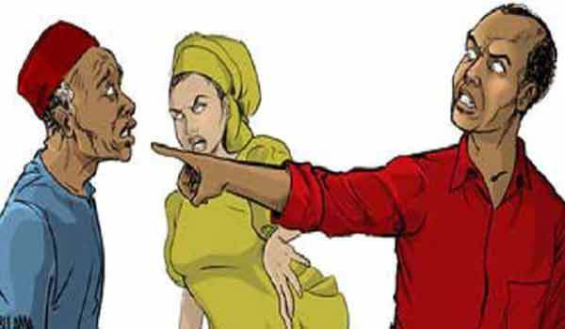
Disrespecting Elders
Showing disrespect to elders is considered highly taboo in Gambian culture. Elders are revered for their wisdom and experience, and any form of disrespect is frowned upon.

Slide 6
Public Displays of Affection
Public displays of affection, such as kissing and hugging, are generally considered taboo. Gambian society tends to uphold more conservative values regarding romantic relationships.

Slide 7
Pointing with the Index Finger
Pointing directly at someone or something using the index finger is often considered impolite. It is preferred to use the whole hand or gesture subtly with the chin.

Slide 8
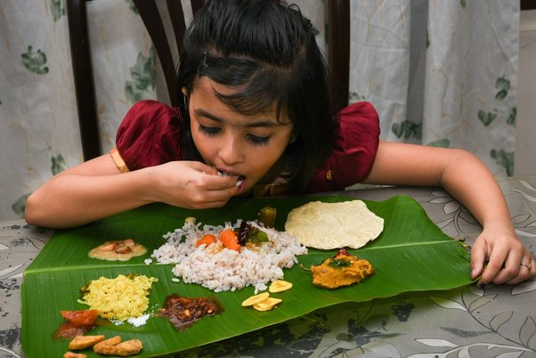
Using the Left Hand
The left hand is traditionally considered impure in Gambian culture. Using it for actions like giving or receiving items is often avoided, with the right hand being the preferred choice.

Slide 9
Discussing Personal Matters Publicly
Openly discussing personal matters, especially within the family, is considered taboo. Privacy is highly valued, and discretion in communication is expected.

Slide 10
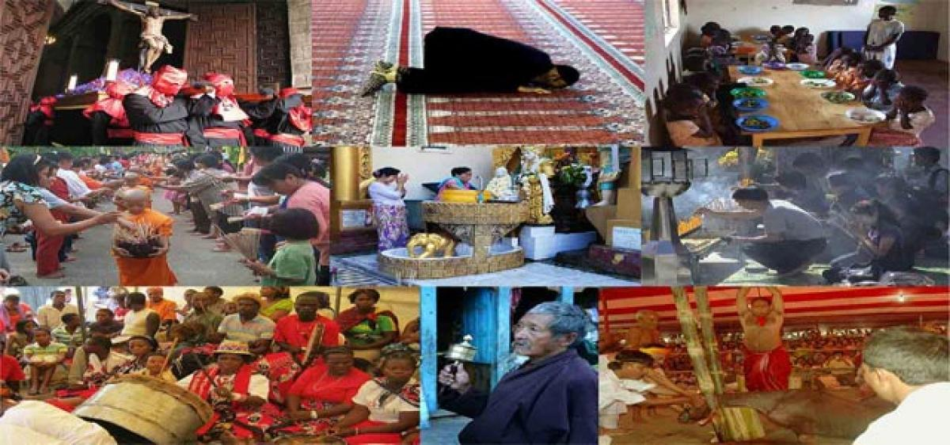
Disrespecting Religious Practices
Gambians, predominantly Muslim, hold their religious practices in high regard. Disrespecting or interfering with religious rituals and observances is considered offensive.

Slide 11
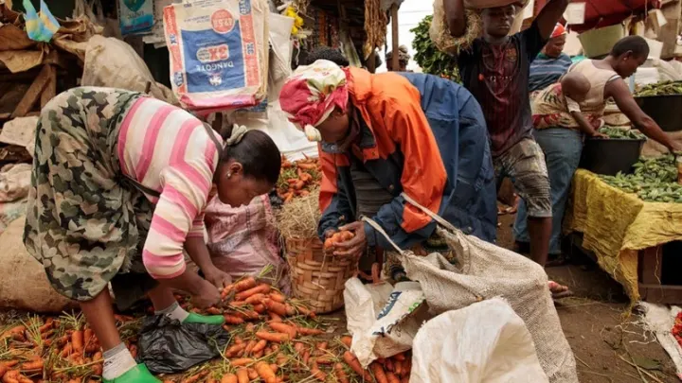
Wasting Food
Wasting food is strongly discouraged. In a culture where resources may be limited, the importance of appreciating and conserving food is emphasized.

Slide 12
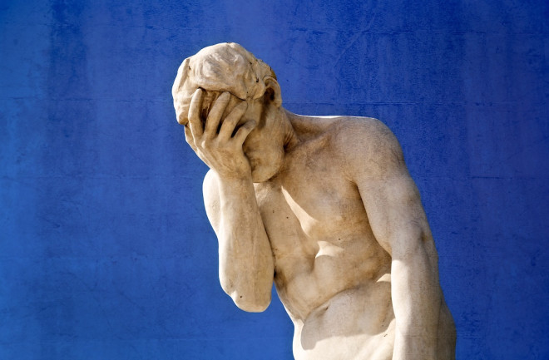
Public Criticism or Shame
Criticizing or shaming someone publicly is culturally unacceptable. Issues and conflicts are typically addressed privately to avoid causing embarrassment.

Slide 13
Speaking Loudly in Public Spaces
Speaking loudly in public spaces, particularly in a confrontational manner, is considered inappropriate. Maintaining a calm and composed demeanor is valued.

Slide 14
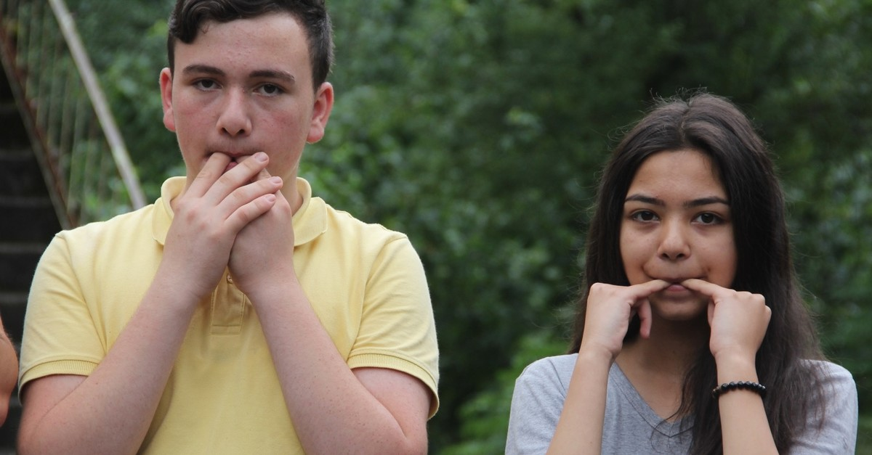
Whistling at Night
Whistling at night is often associated with attracting spirits or supernatural entities in Gambian folklore. It is considered taboo, especially in rural communities.

Slide 15
Interfering with Sacred Sites
Disturbing or disrespecting sacred sites, which often hold spiritual significance, is considered a serious taboo. These sites are treated with reverence.

Slide 16
Crossing Legs in the Presence of Elders
Crossing legs while sitting in the presence of elders is seen as a sign of disrespect. It is customary to sit with legs uncrossed as a gesture of deference.

Slide 17
Openly Declining Hospitality
Openly declining food or hospitality from a host can be considered impolite. It is customary to accept offerings graciously, even if only a small amount is consumed.

Slide 18
Negative Comments about the Country
Making derogatory remarks about The Gambia or its people is socially inappropriate. Expressing negativity about the country is generally discouraged.

Slide 19
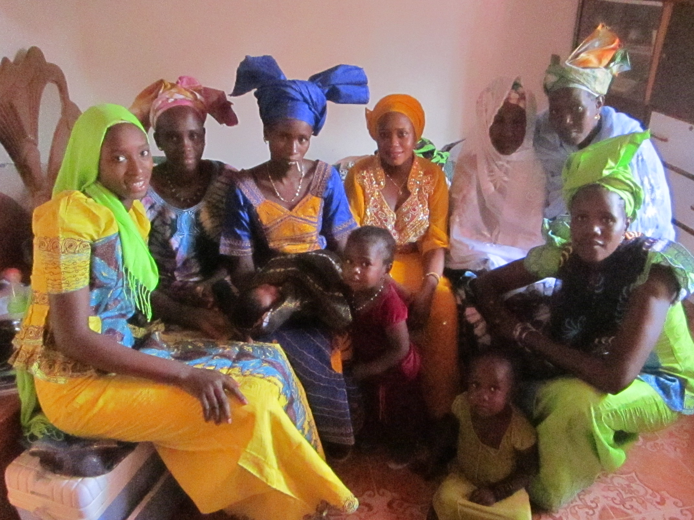
Naming a Child after a Living Relative
Naming a child after a living relative is often avoided to prevent bringing bad luck to both the child and the namesake.

