Slide 1
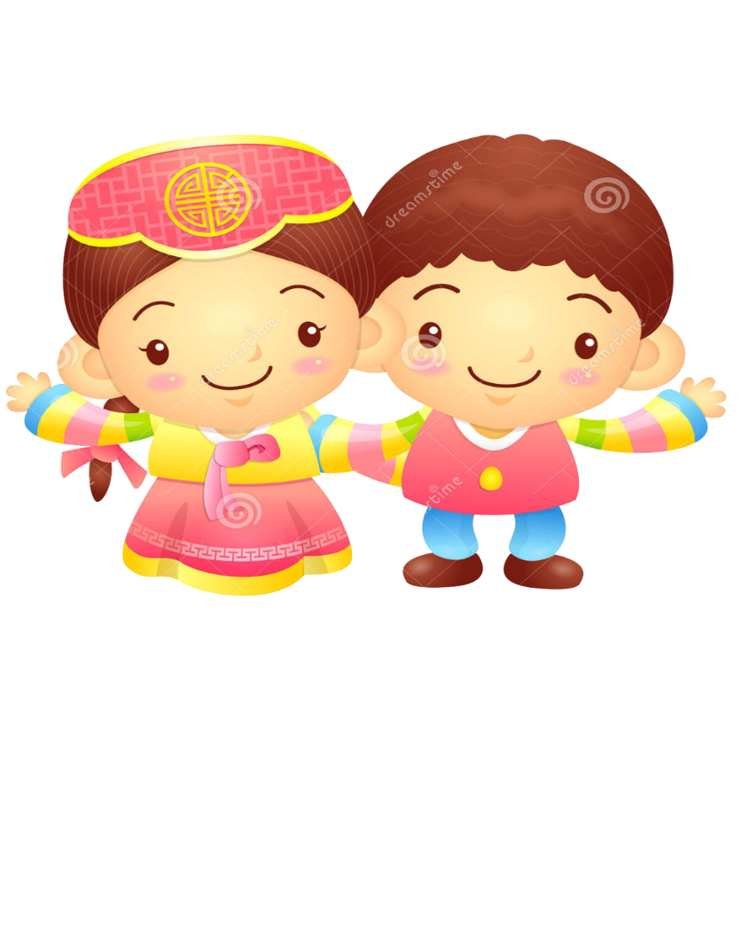
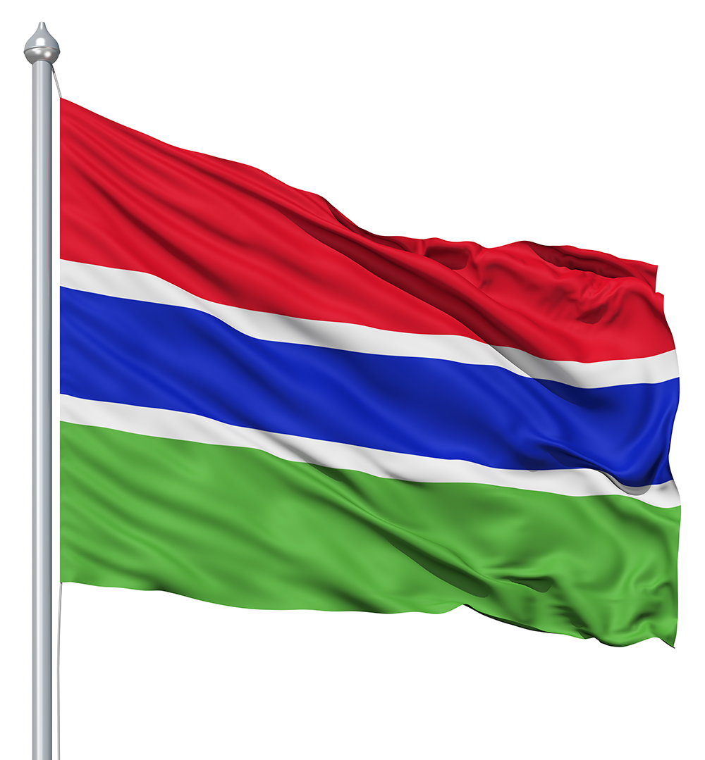
HOMELAND－The Gambia West Africa

Slide 2
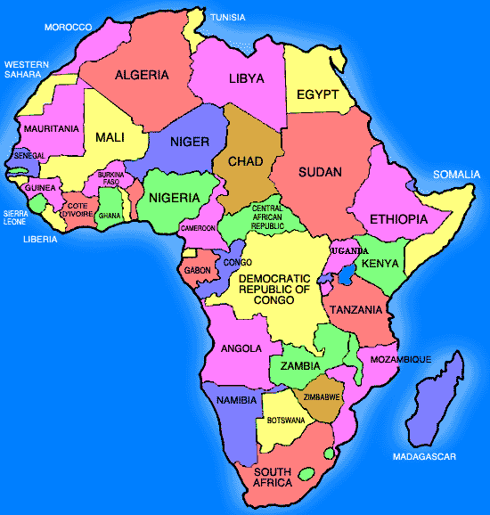
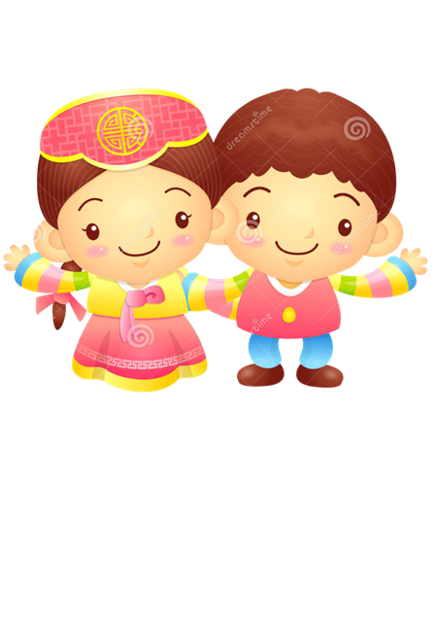
Gambia

Slide 3
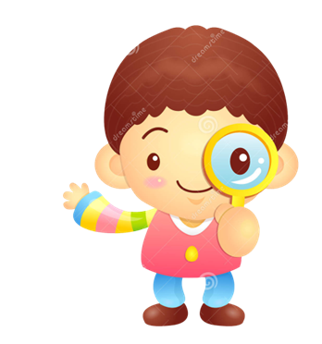
The colours of the Gambian flag:
Red: Sun
White: Freedom & Peace
Blue: The River Gambia
Green: Nature & Agriculture

Slide 4
Why is culture important ?
Culture Shapes Our Identities
Culture Gives Us a Sense of Belonging
Culture Helps Us Connect with Others
Culture Helps Us Express Ourselves
Culture Can Bring People Together
Culture Can Help Us Preserve Our History and Tradition

Slide 5
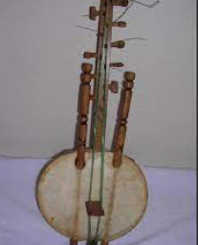
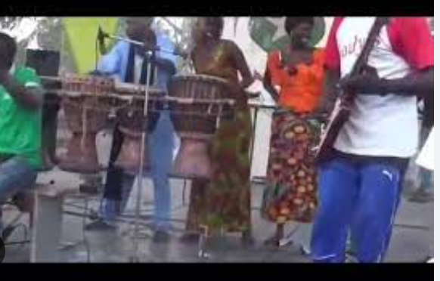
TRADITIONAL MUSIC
A 21 string hard made with a calabash and animal hide mostly from cows. Its associated with the madinka tribe
Includes a talented drummer with three or more drums
The drum is made from tree trunk and animal skin

Slide 6
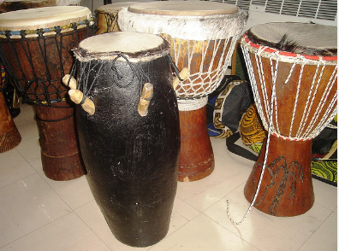
TRADITIONAL MUSIC
High-energy dance accompanied by the sabar drums, popular among the Wolof ethnic group.

Slide 7
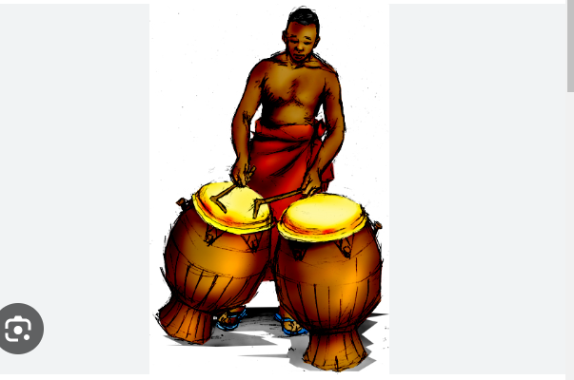
DRUMS AS A MEANS OF COMMUNICATION
FUNERALS
NAMING CEREMONIES
ANNOUNCEMENT
SENDING SPECIFIC MESSAGES

Slide 8
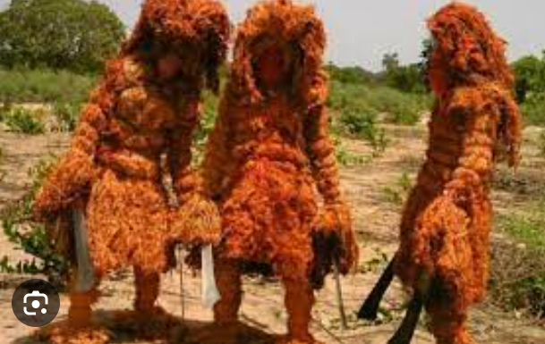
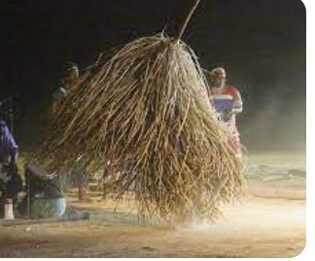
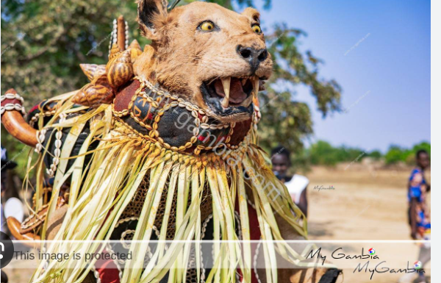
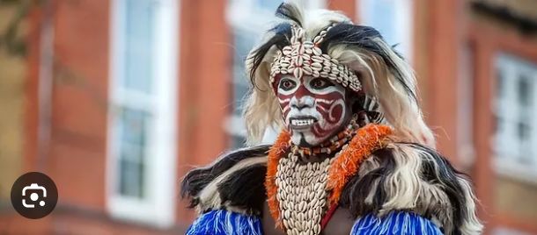
Local Festivals and Celebrations
KANKURANG
KUMPO
SIMBA
HUNTING

Slide 9
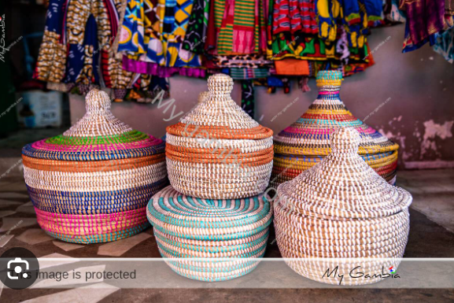
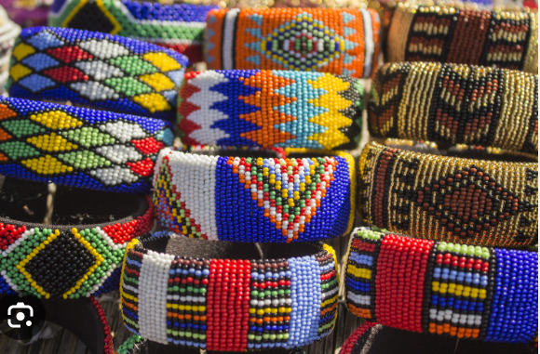
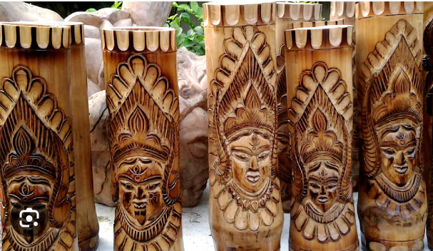
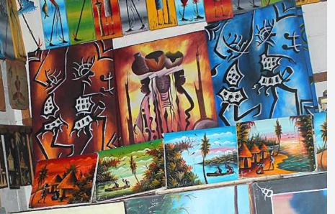
ARTS AND CRAFT

Slide 10
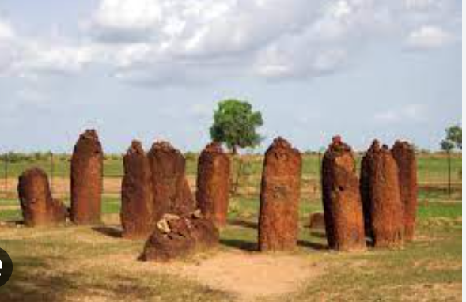
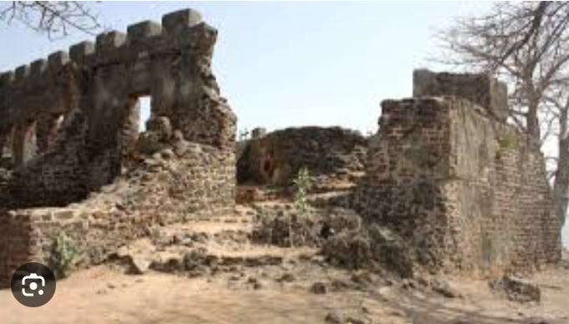
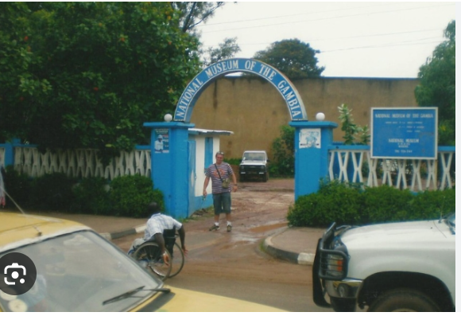
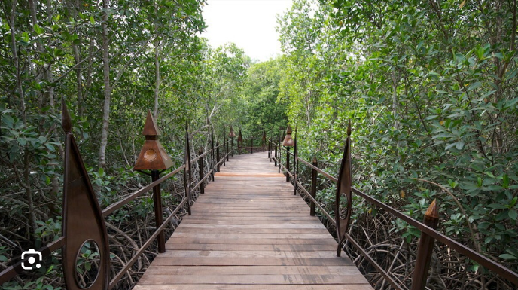
CULTURAL HERITAGE SITES
STONE CIRCLE
FORT BULLEN
NATIONAL MUSEUM
ABUKO NATURE RESERVE

Slide 11
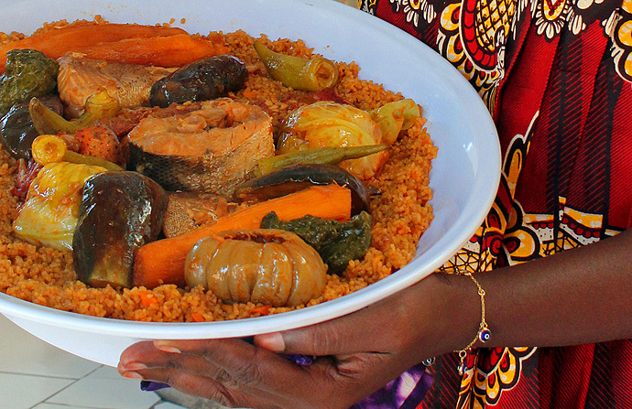
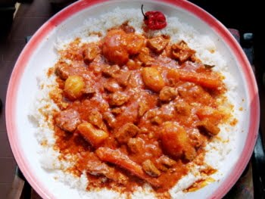
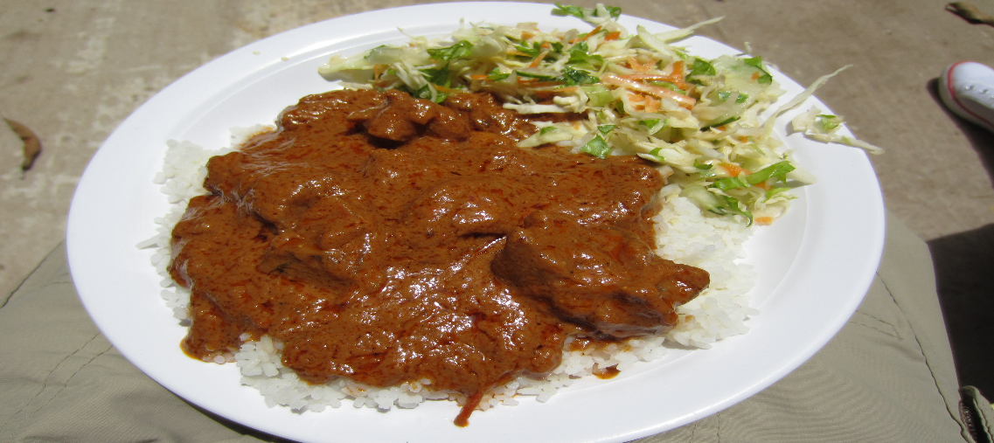
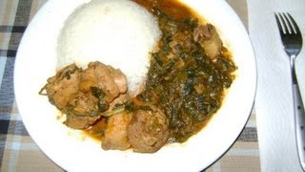
DISHES
Benachin
Chew Dulin
Domodah
Fufu

Slide 12
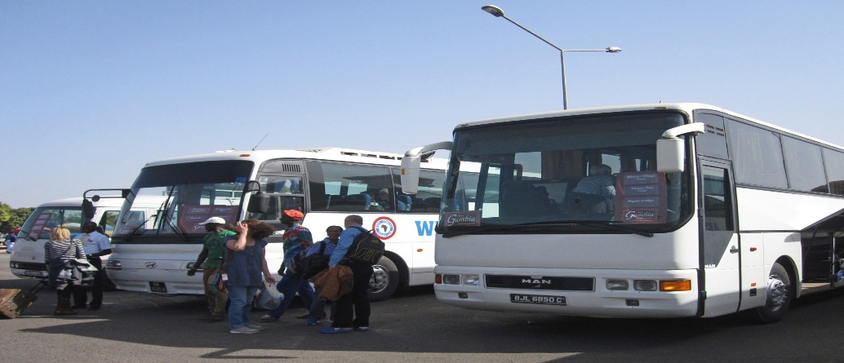
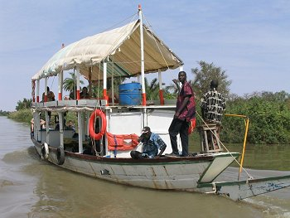
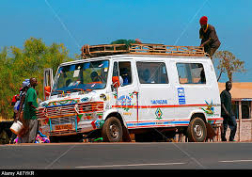
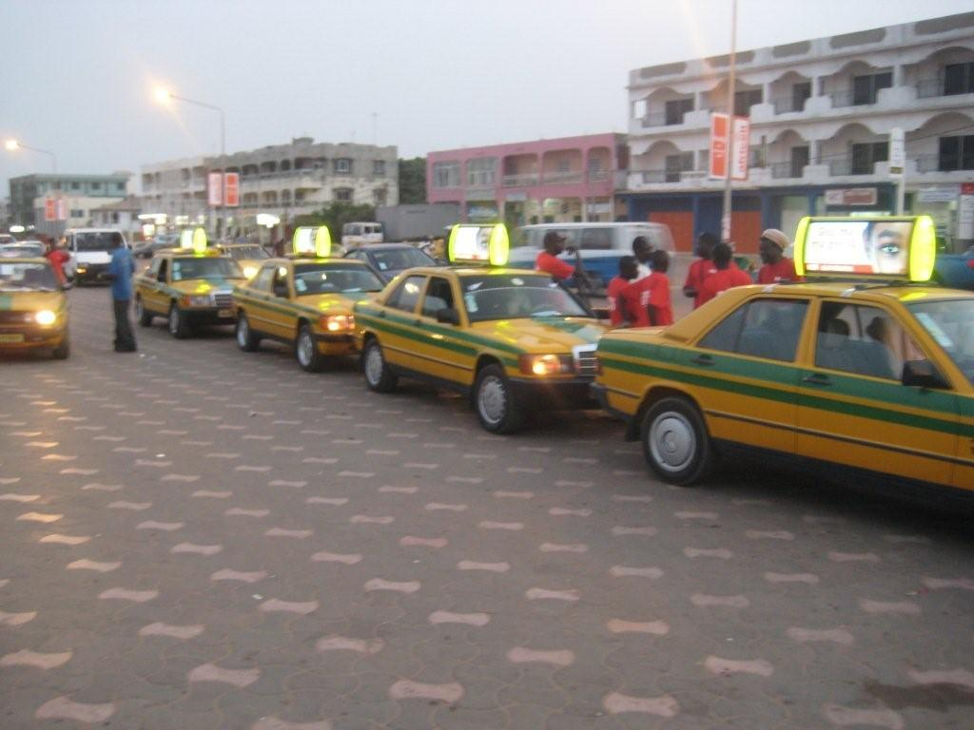
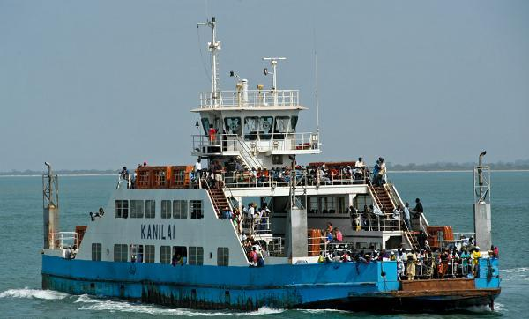
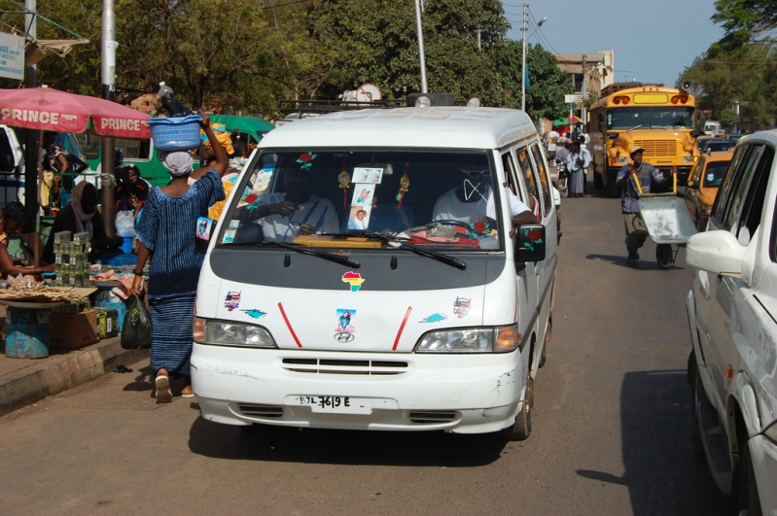
TRANSPORTATION

Slide 13
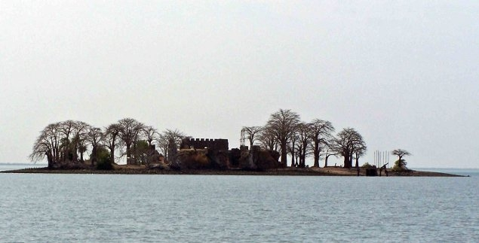
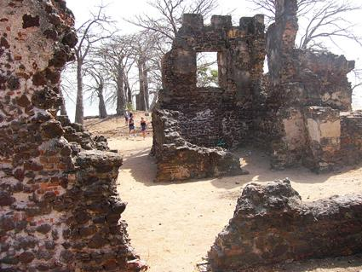
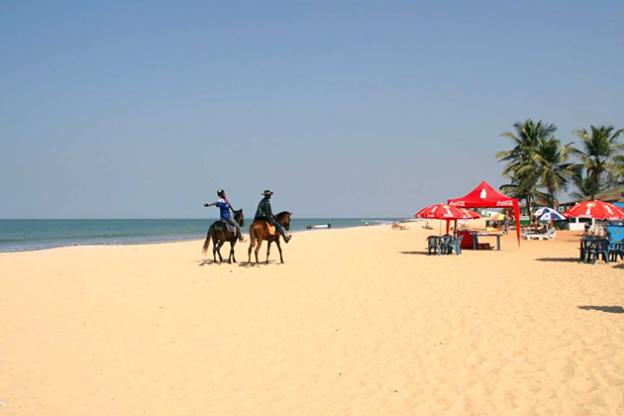
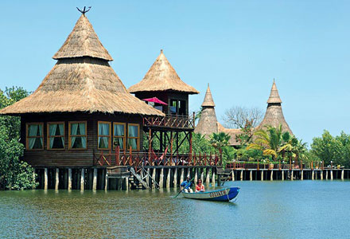
TOURISM
Juffereh
James Island
Senegambia Beach
Maka-Sutu Eco-Lodge

Slide 14
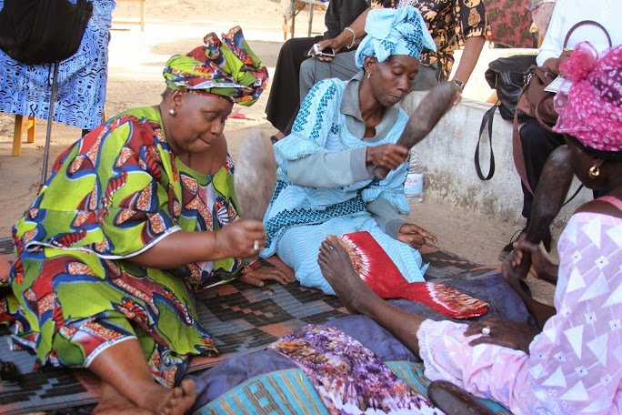
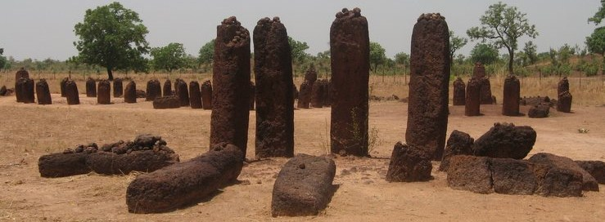
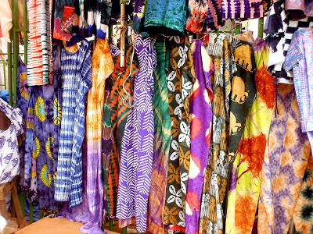
TOURISM
Batik
Wassu, Stone Cycle

Slide 15
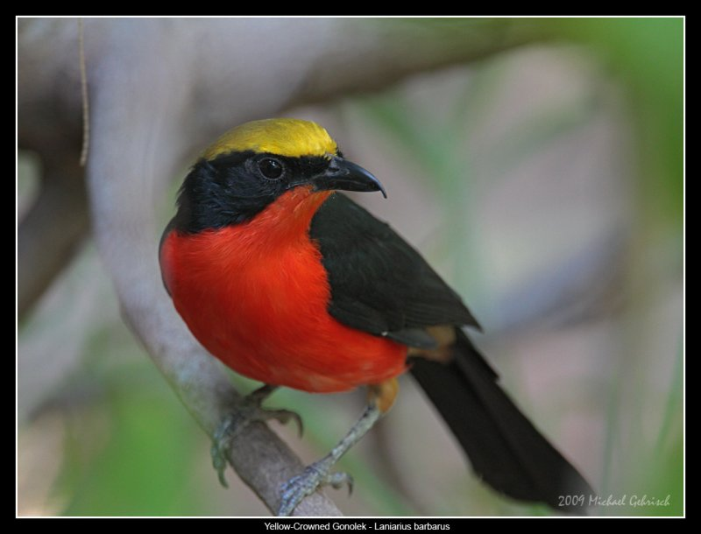
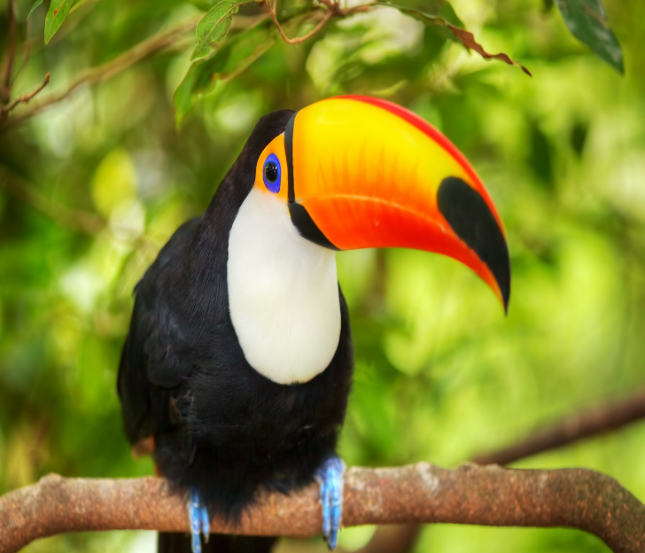
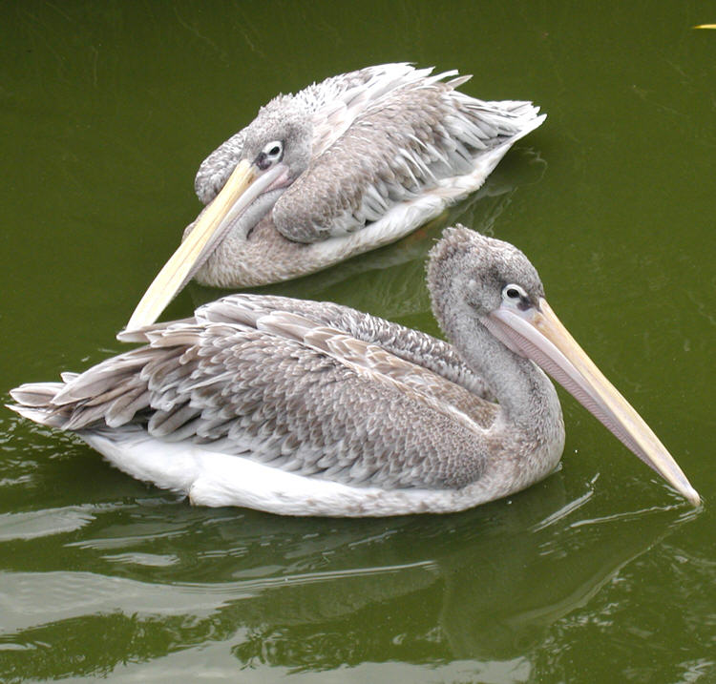
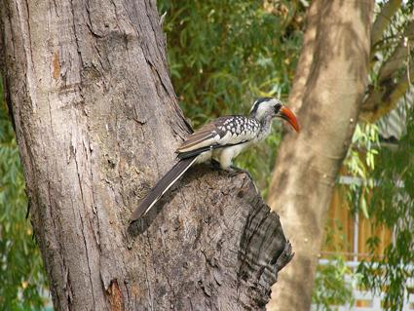
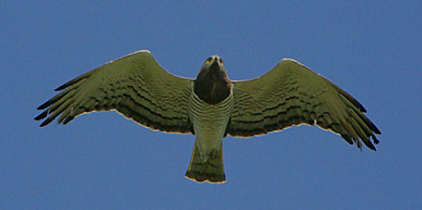
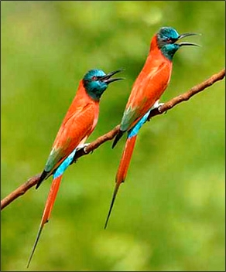
Birdlife

Slide 16
In Gambia, it is common to see people within communities doing things in common

Slide 17
What we are passionate about !
Greeting
Sharing
Keeping family ties
Respect for elders

Slide 18
Q&A

Slide 19
Thank you ♥

