Slide 1
Embracing Life in Taiwan
A Journey of Achievements, Friendship, and Global Promotion

Slide 2
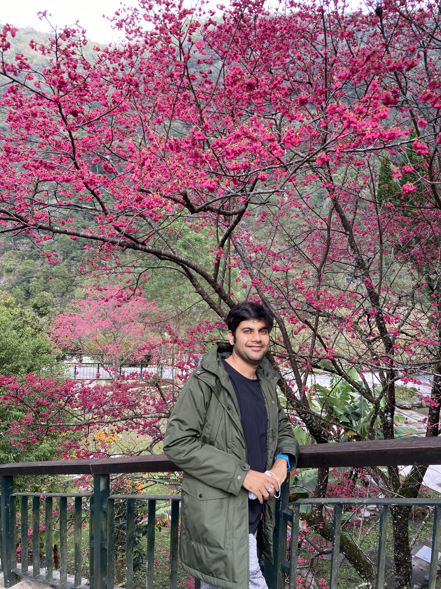
Introduction
Name- Mohd Yaqub Khan (莫陽凱)
Nationality: Indian (印度人)
Education: Master in Pharmacy (藥學碩士)
Current status: Pursuing PhD. In Biomedical engineering at Chung Yuan Christian University. (正在攻讀博士學位。中原大學生物醫學工程系)
Passion & Interests: Photography, Travelling. Blogging, Hiking,& Running.
(攝影、旅行。寫部落格、健行和跑步)

Slide 3
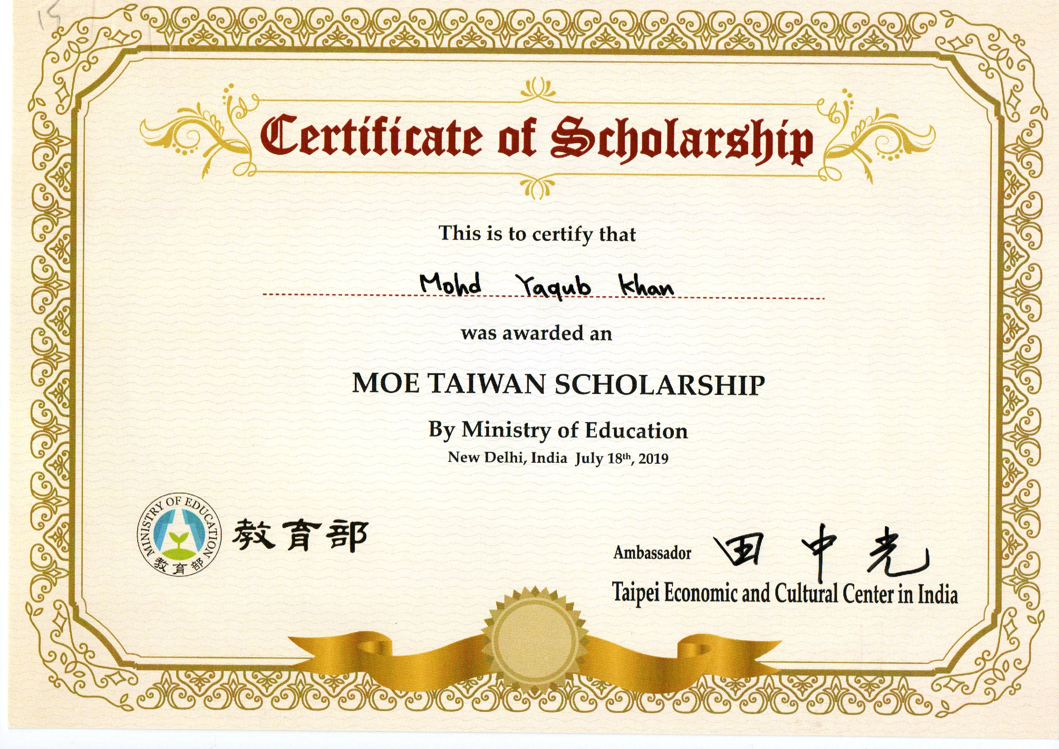
Fund Achievements
Received Ministry of Education Scholarship to pursue PhD study in Taiwan.
(3,20,000 ntd annually for 4 years)
(獲得教育部獎學金赴台灣攻讀博士學位。)
Received Ministry of Science Scholarship to pursue Research study on Cancer treatment.
(5,00, 000 ntd annually for 3 years)
(獲得科學部獎學金進行癌症治療研究。)

Slide 4
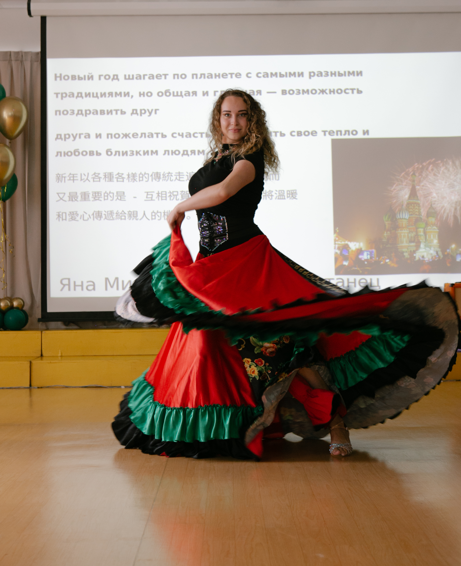
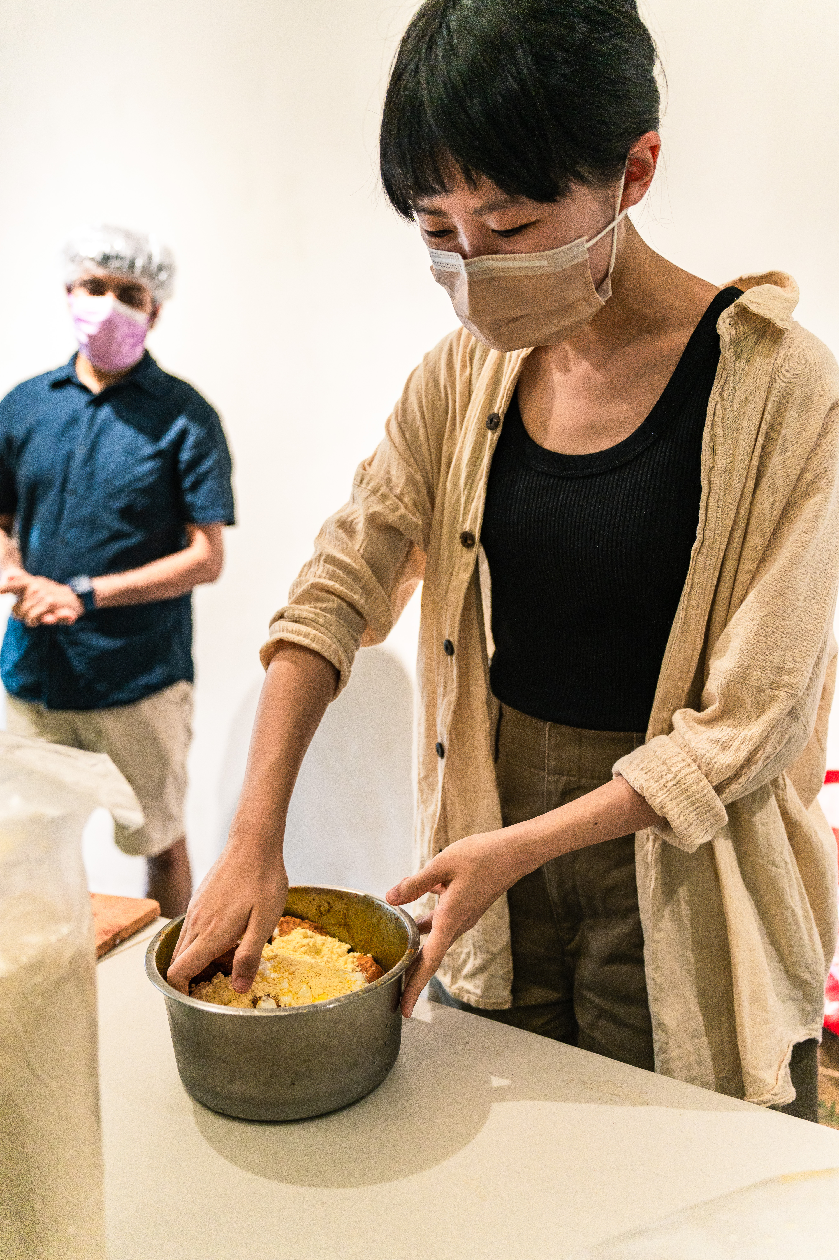
Cultural Events
Taiwan hosts vibrant cultural events, blending traditional and modern elements. Festivals, art exhibitions, and performances showcase the island's rich heritage.
(台灣舉辦充滿活力的文化活動，融合傳統與現代元素。節慶、藝術展覽和表演展示了島上豐富的遺產。)

Slide 5
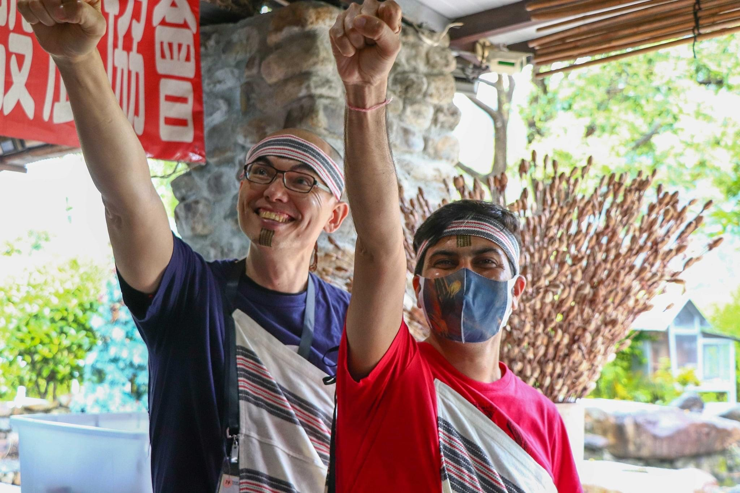
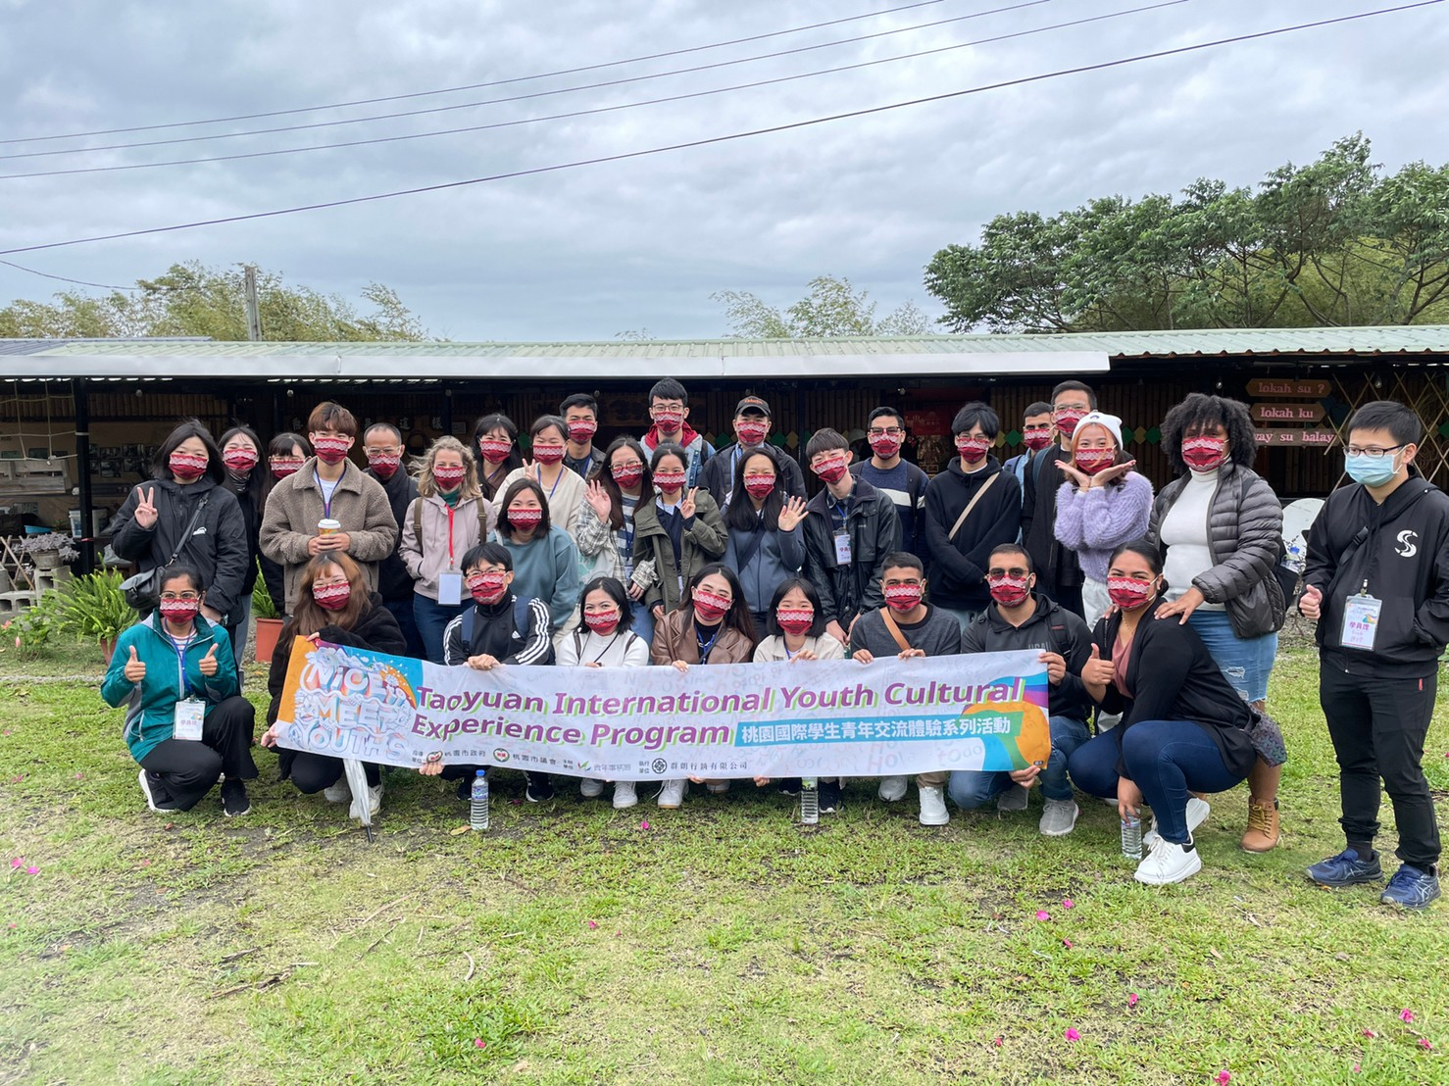
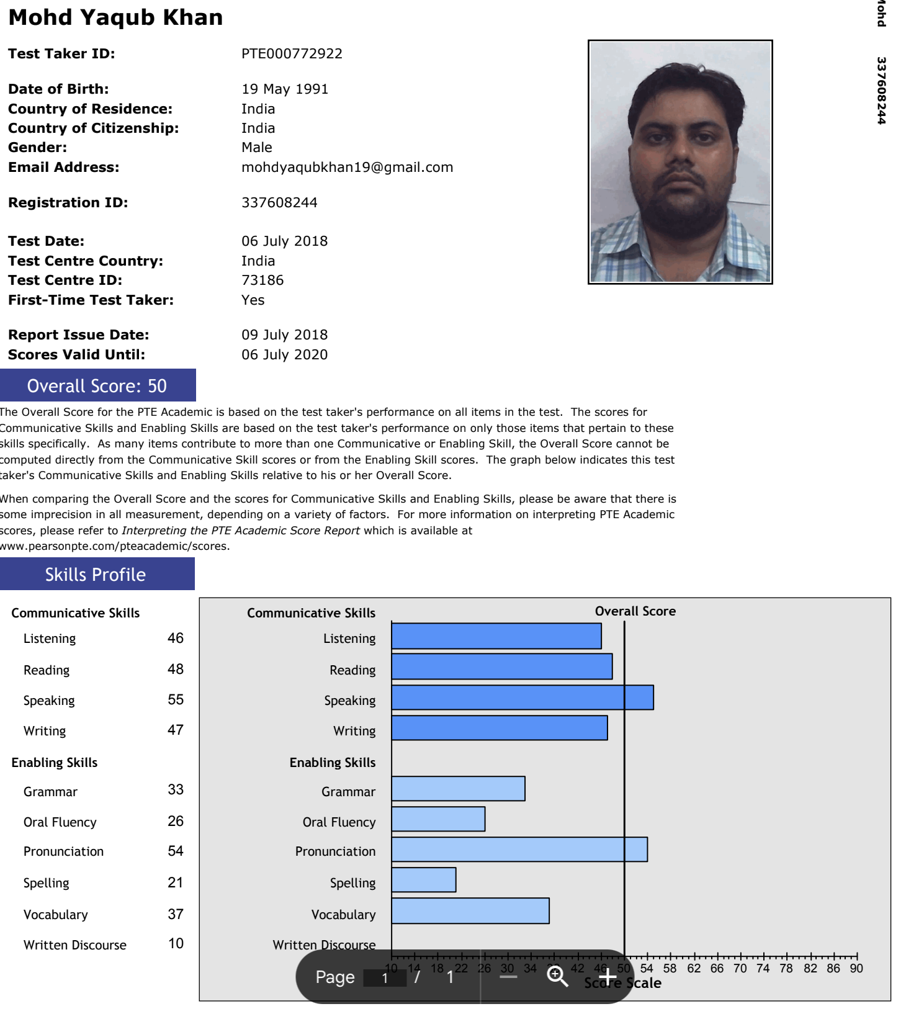
Language Exchange
Language exchange thrives in Taiwan, offering locals and foreigners a chance to swap linguistic skills, fostering cultural understanding and friendships.
(台灣的語言交流蓬勃發展，為當地人和外國人提供了交流語言技能、促進文化理解和友誼的機會。)

Slide 6
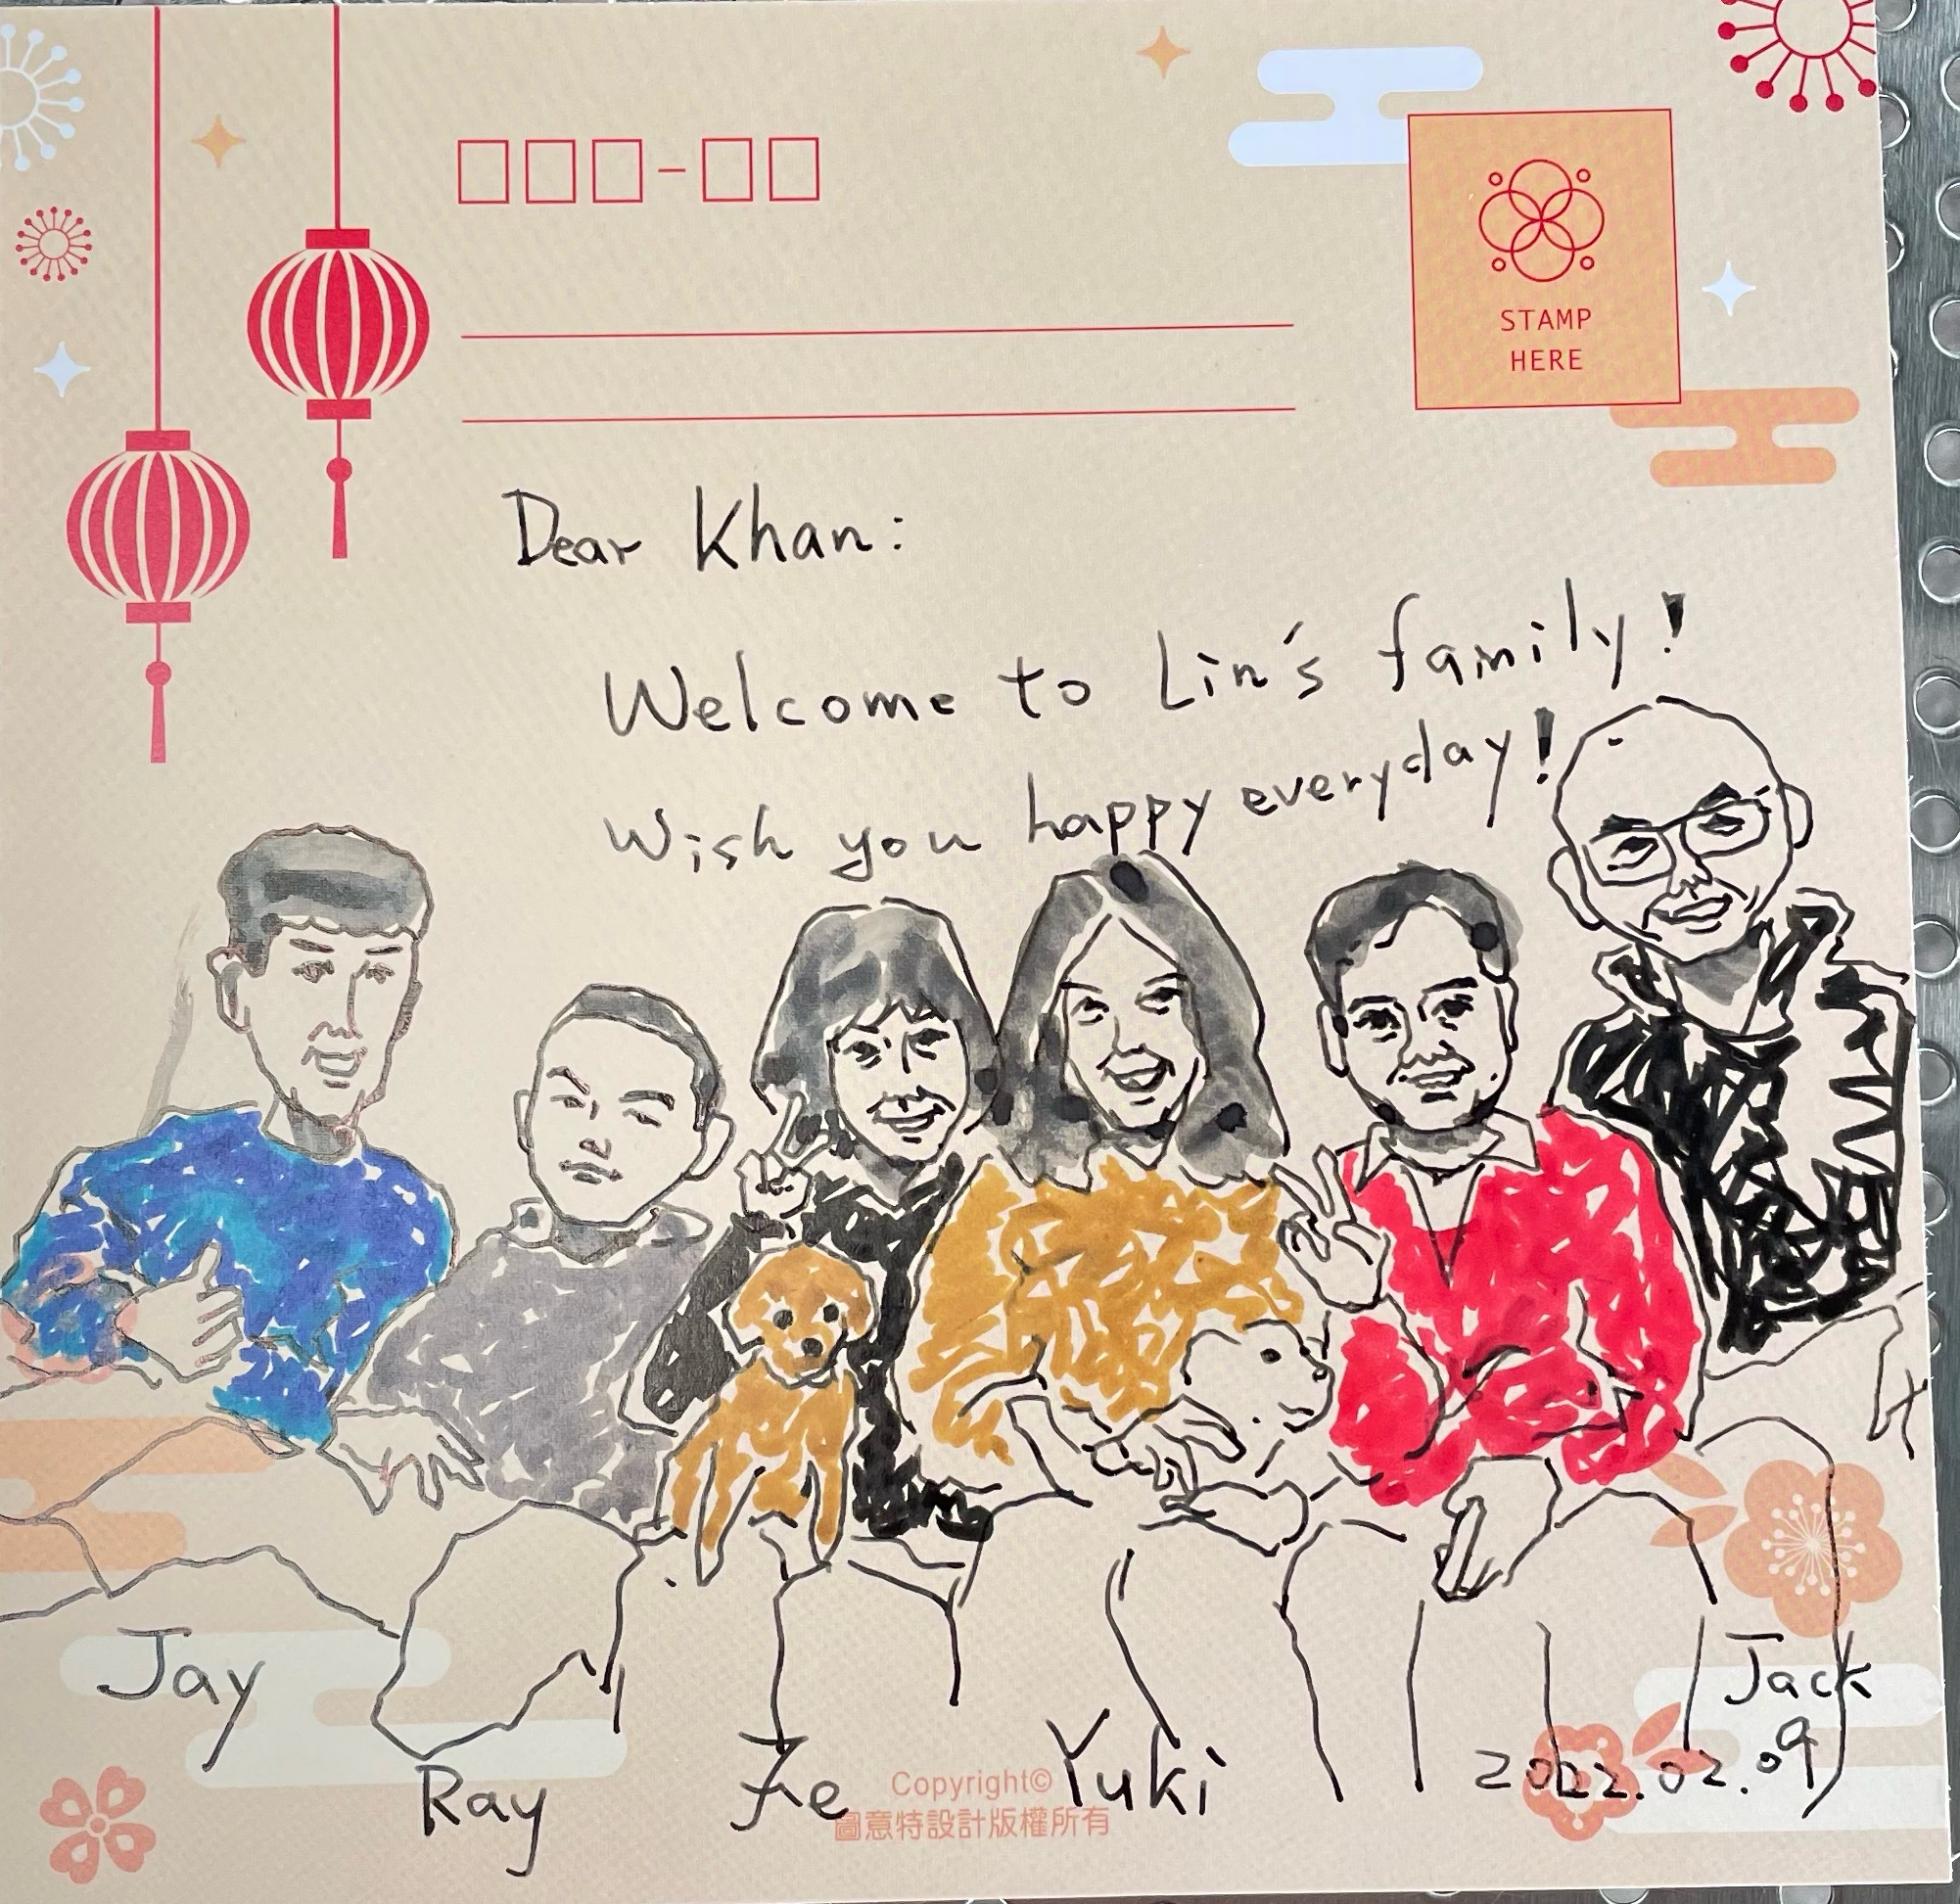
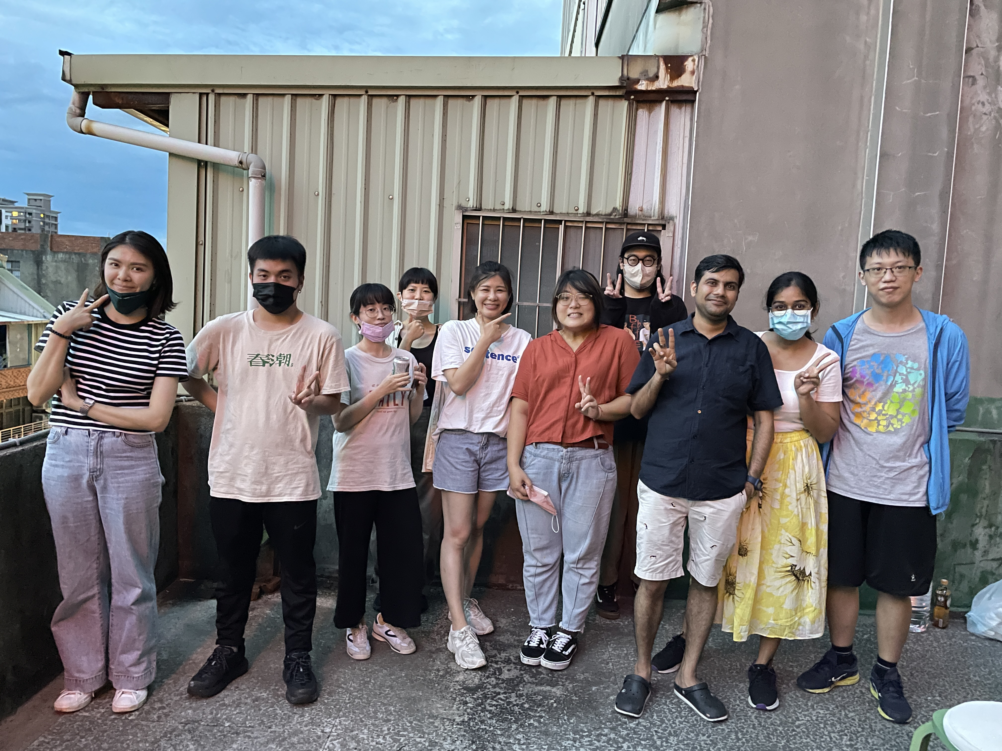
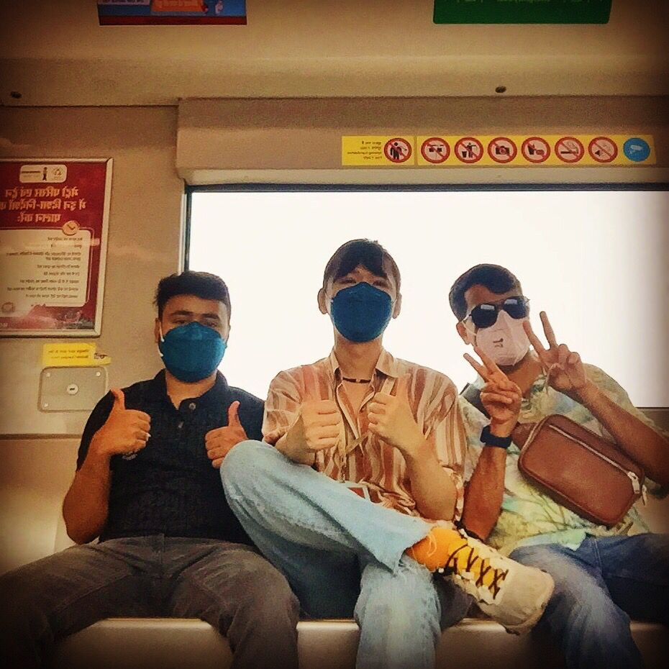
Friendship
Friendship in Taiwan is cherished, marked by warmth, hospitality, and shared experiences. Social bonds play a pivotal role in Taiwanese culture.
(台灣的友誼是值得珍惜的，其特徵是熱情、好客和分享經驗。社會紐帶在台灣文化中扮演著舉足輕重的角色。)

Slide 7
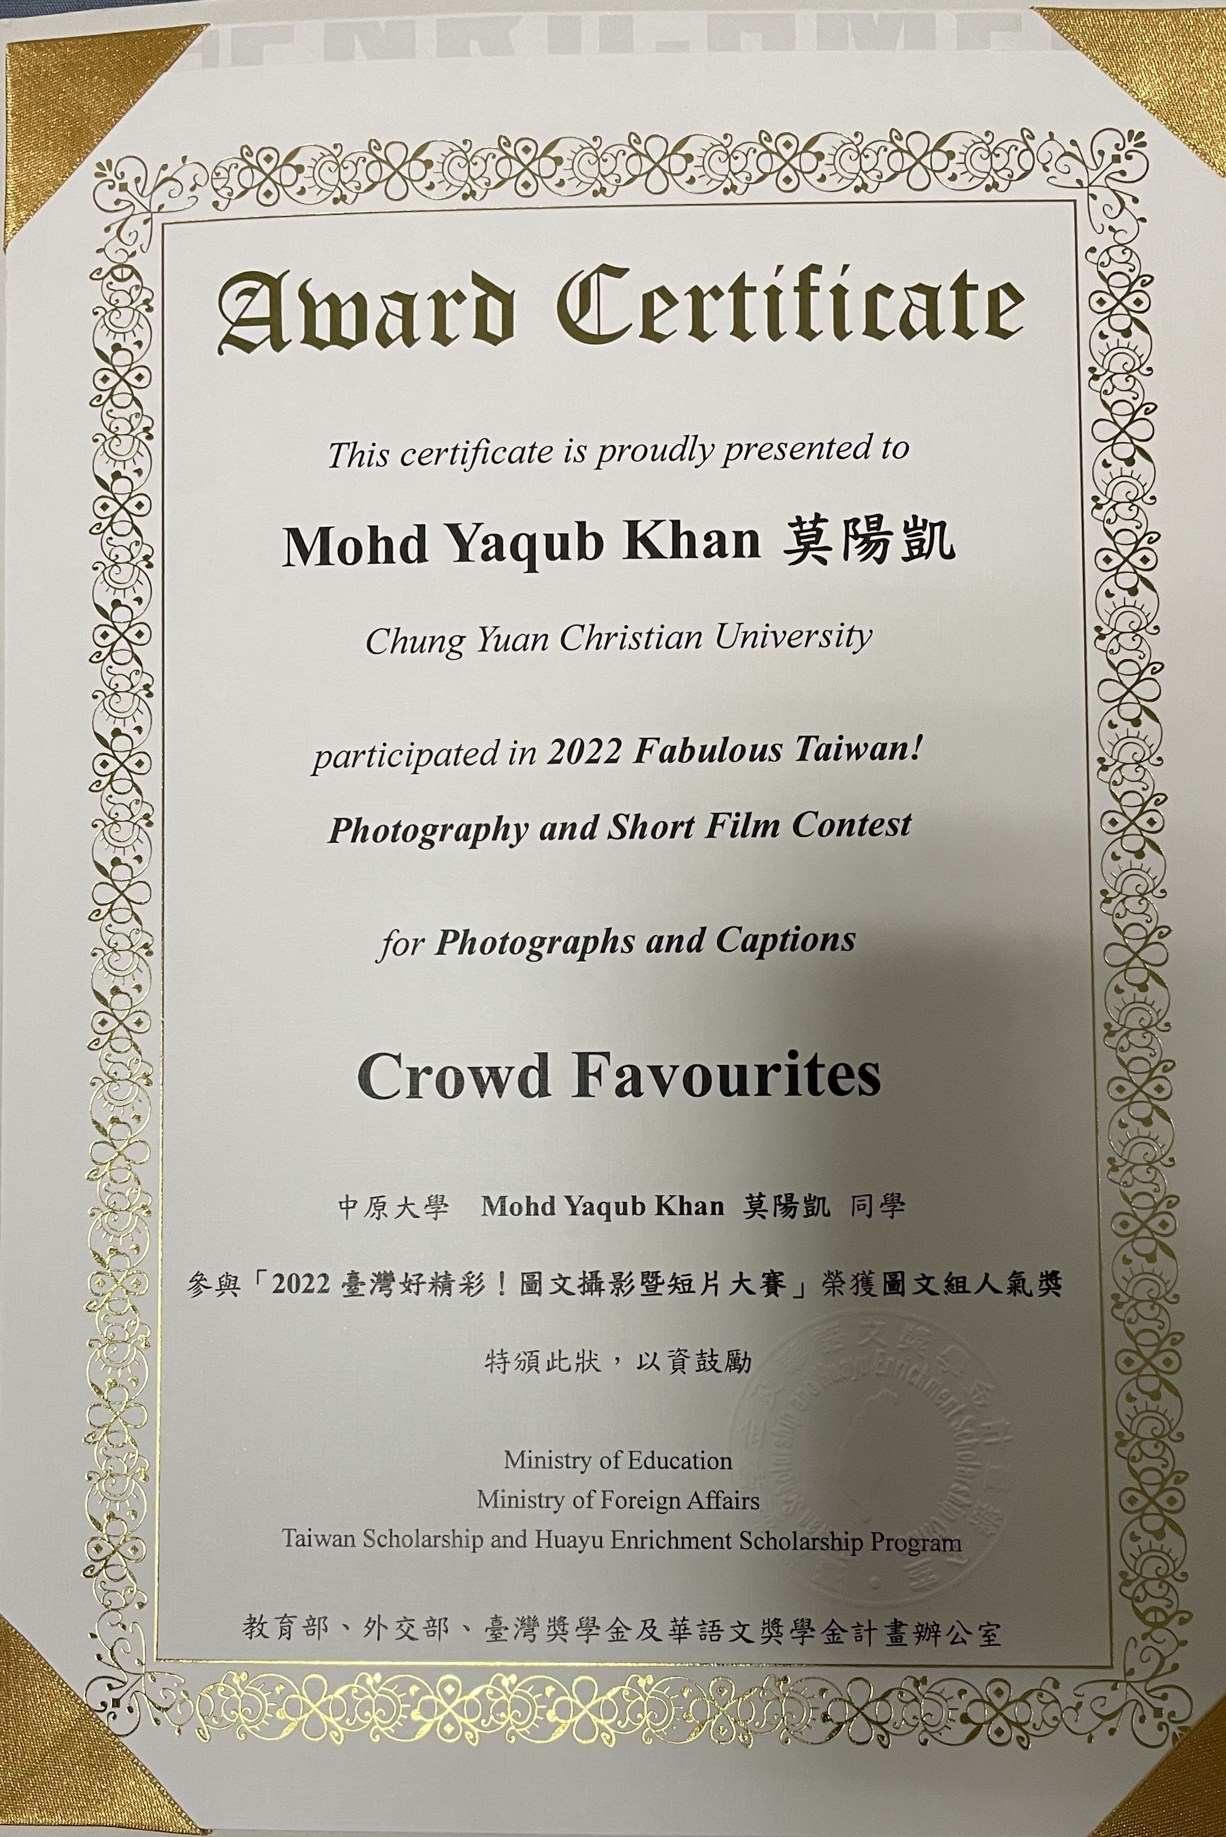
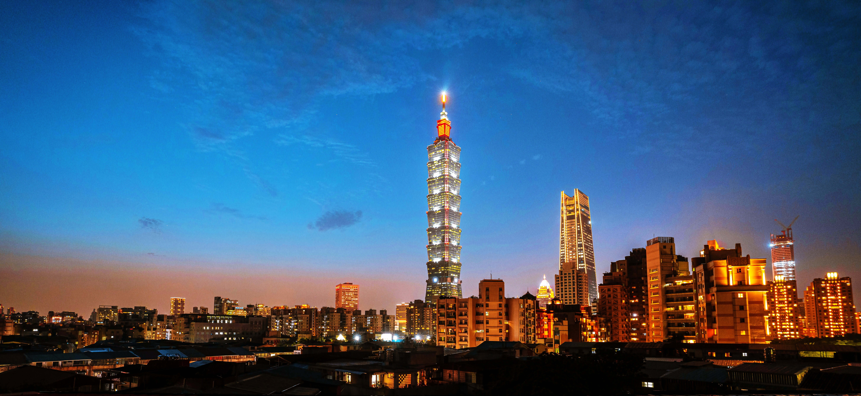
Photography
Photographing Taiwan captures its diverse landscapes, vibrant street scenes, and rich cultural heritage, revealing a tapestry of beauty and uniqueness.
(拍攝台灣，捕捉其多樣化的風景、充滿活力的街景和豐富的文化遺產，展現出一幅幅美麗而獨特的畫卷。)

Slide 8
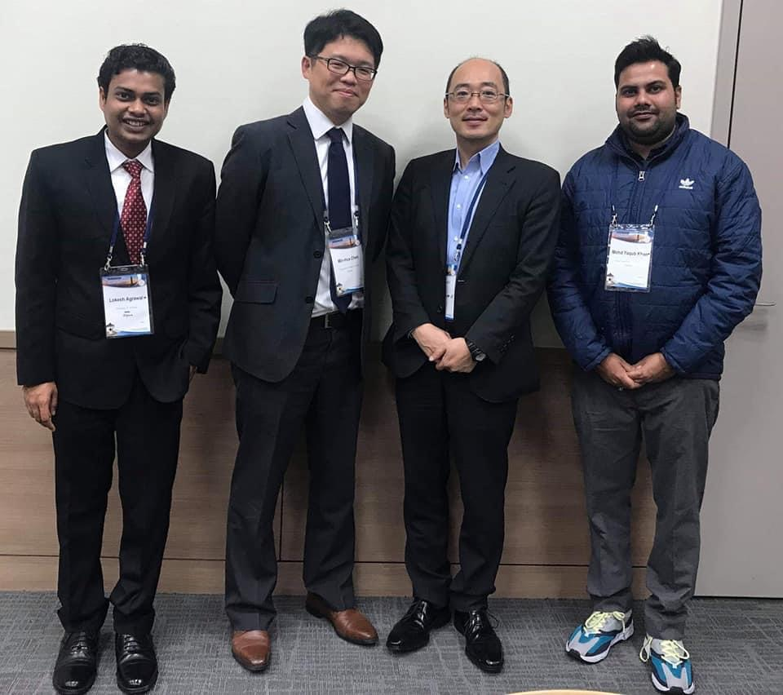
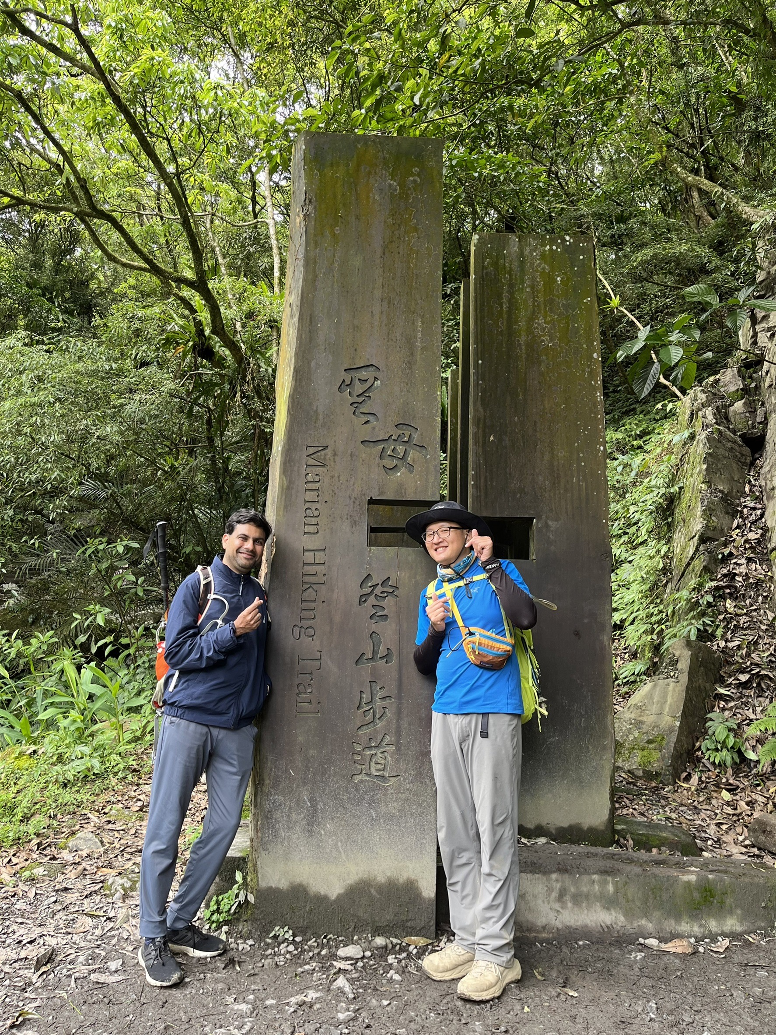
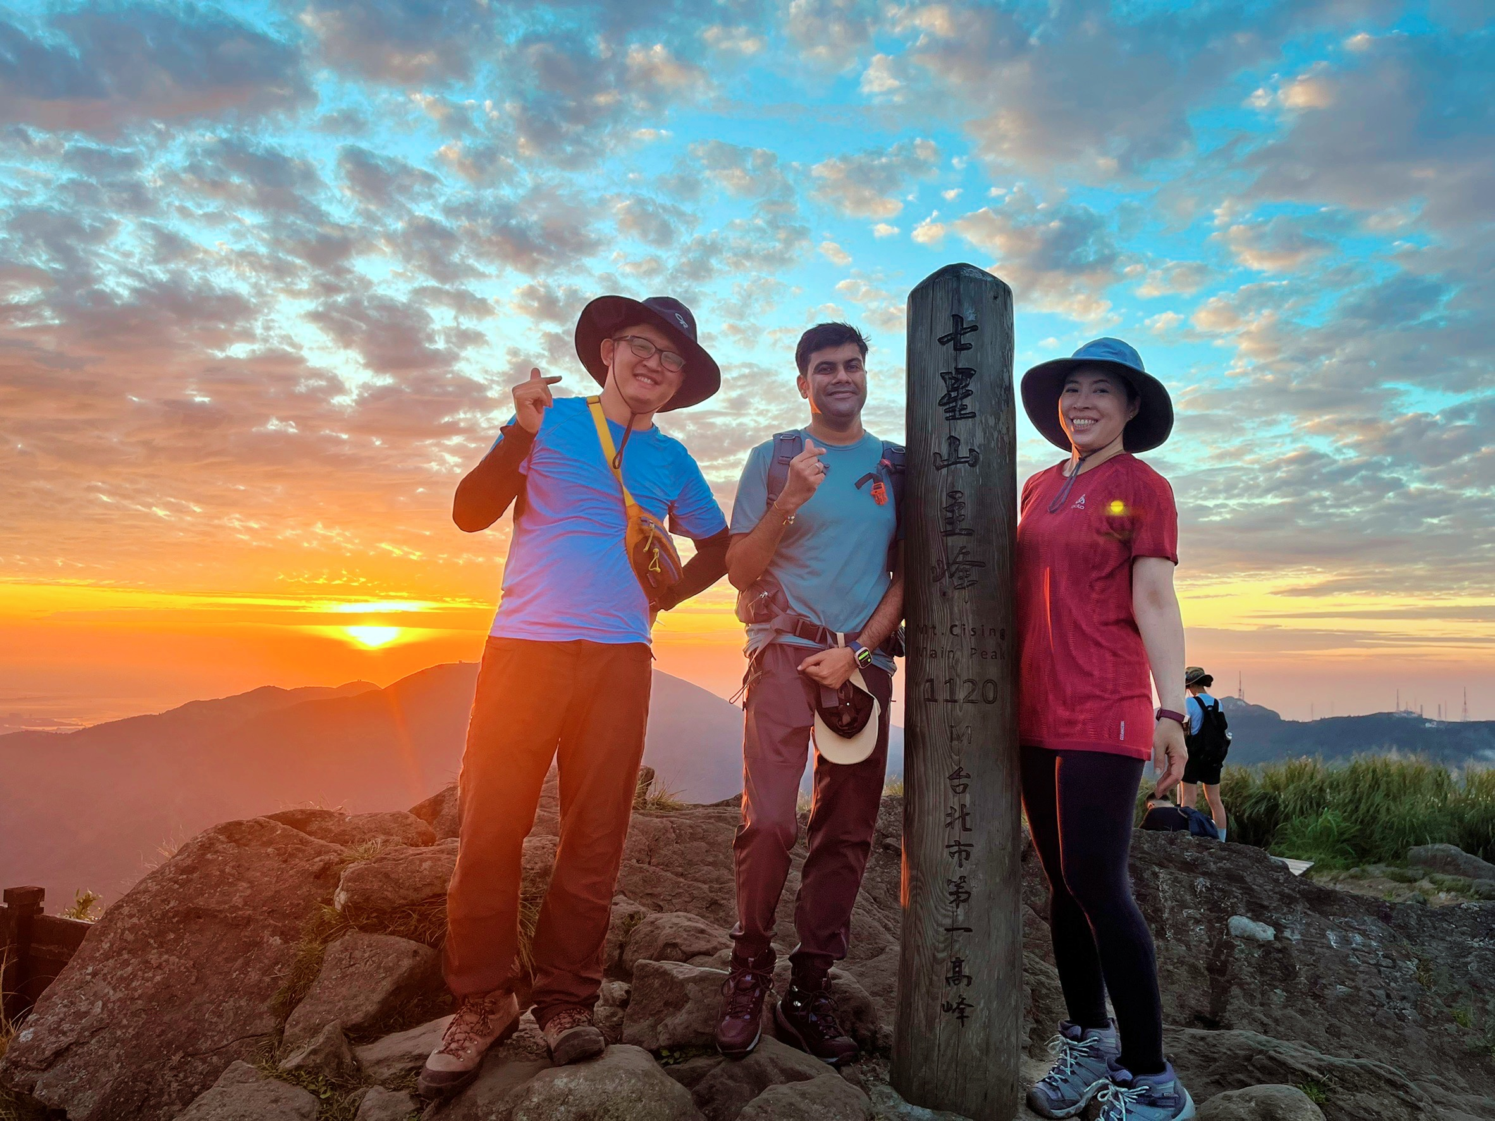
Weight Loss Journey
Embarking on a weight loss journey in Taiwan involves adopting a balanced diet, embracing local active lifestyles, and finding wellness support.
(在台灣踏上減肥之旅需要採取均衡飲食、擁抱當地積極的生活方式以及尋求健康支持。)

Slide 9
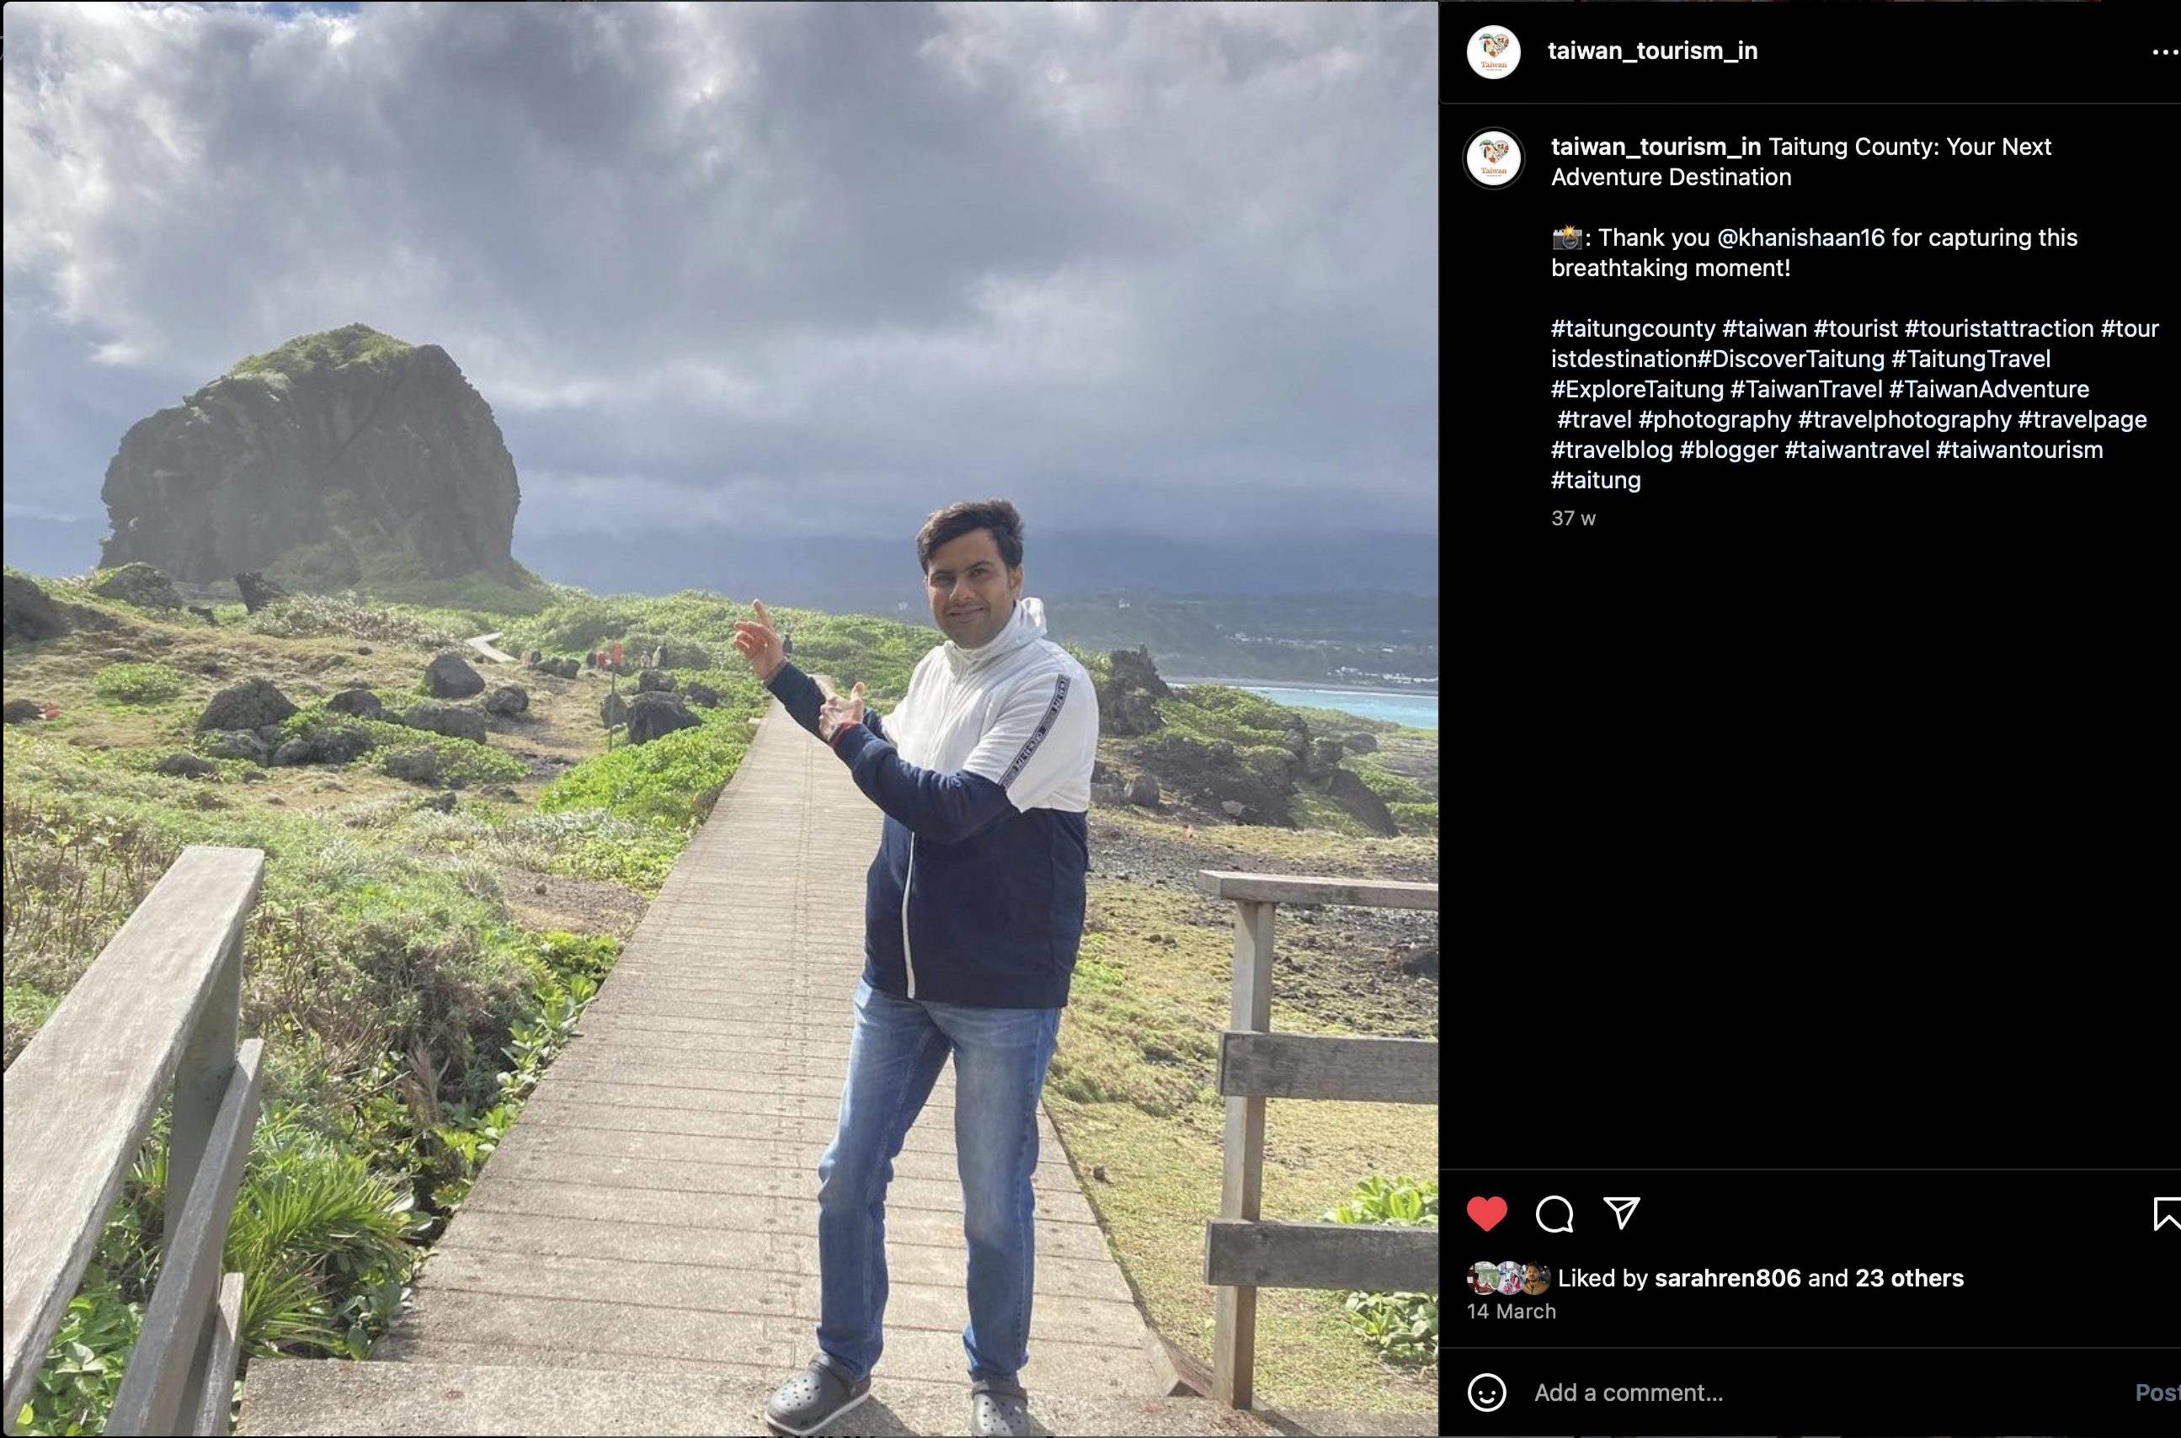
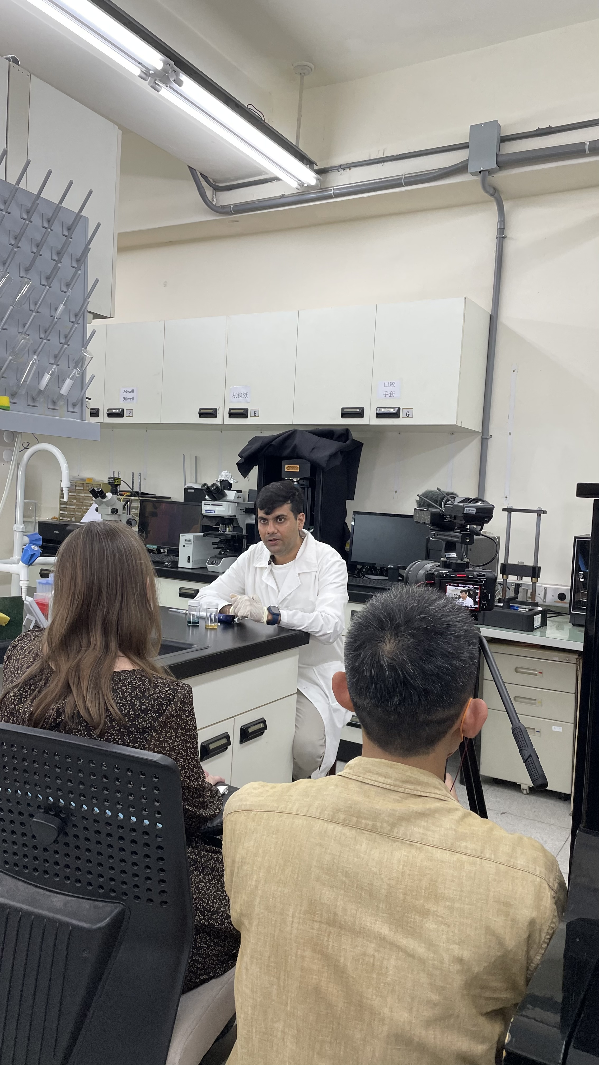
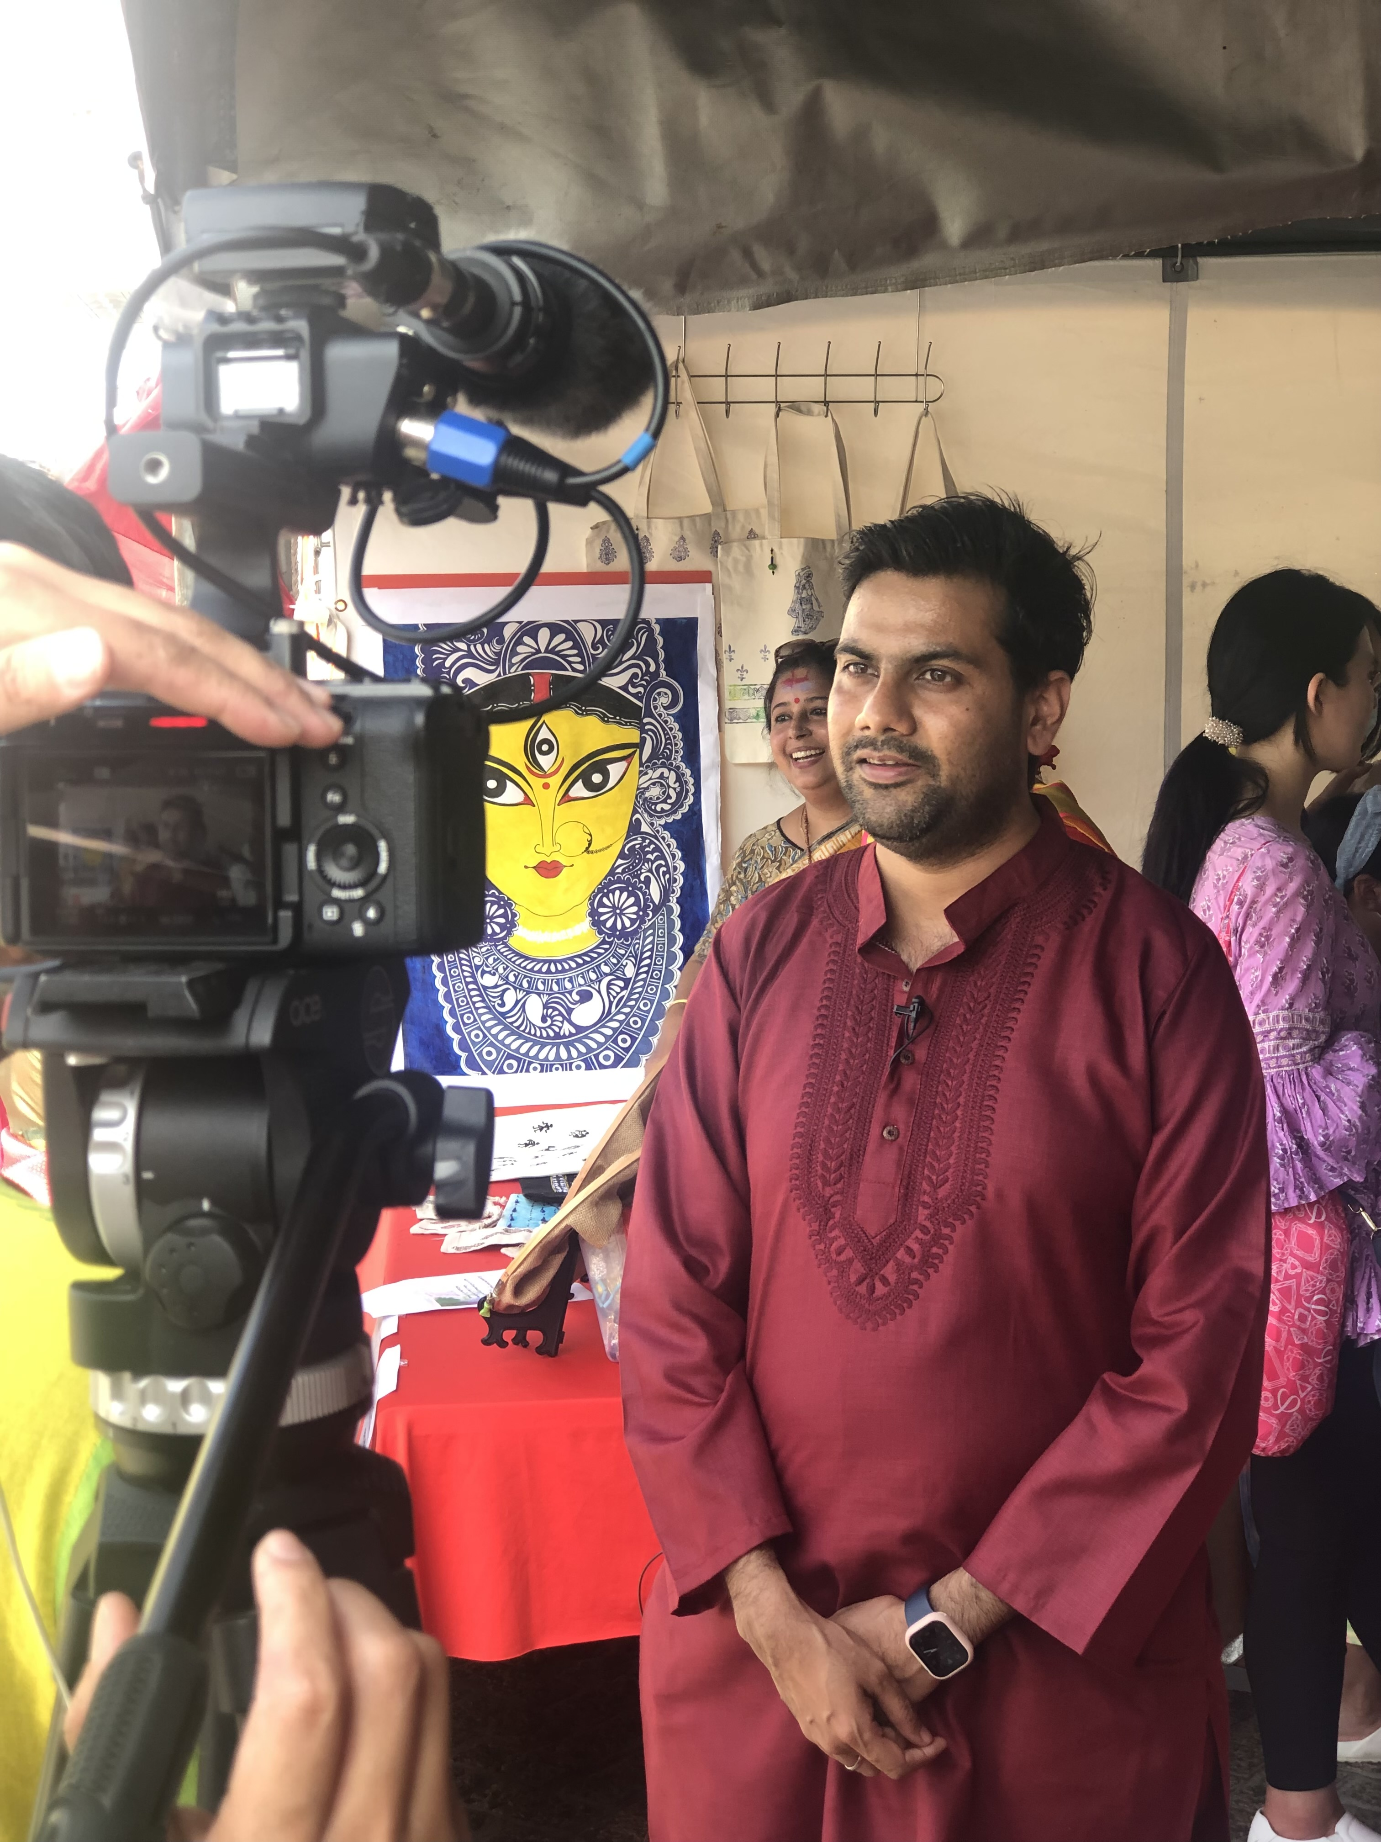
Promoting Taiwan Globally
Showcase Taiwan's allure globally through stunning landscapes, rich culture, and technological prowess, fostering tourism, trade, and international collaborations.
(透過迷人的風景、豐富的文化和技術實力向全球展示台灣的魅力，促進旅遊、貿易和國際合作。)

Slide 10
Q & A

