Slide 1
Dialects and Slangs
Rachel

Slide 2
Country’s Background
Understanding Dialects and Slangs
Dialects and Slangs in SVG
Demonstration
Questions and Answers
Contents

Slide 3
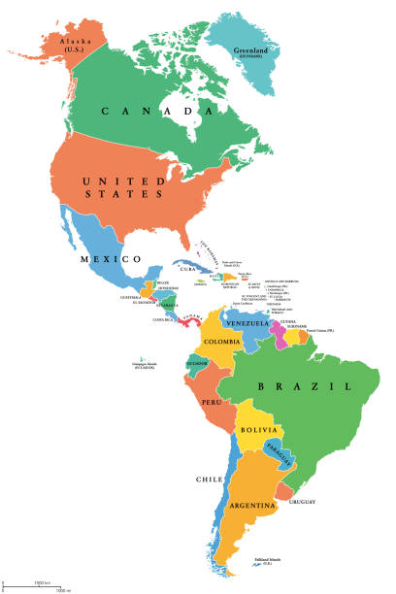
Country’s Background
North America
Caribbean
South America

Slide 4
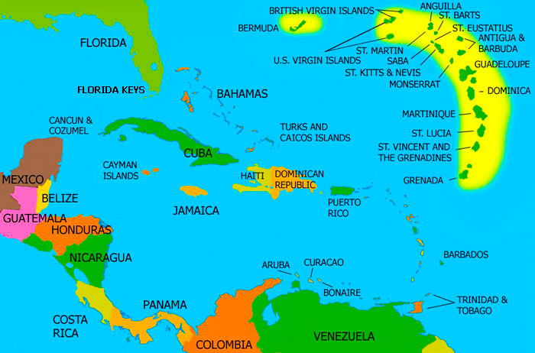

Slide 5
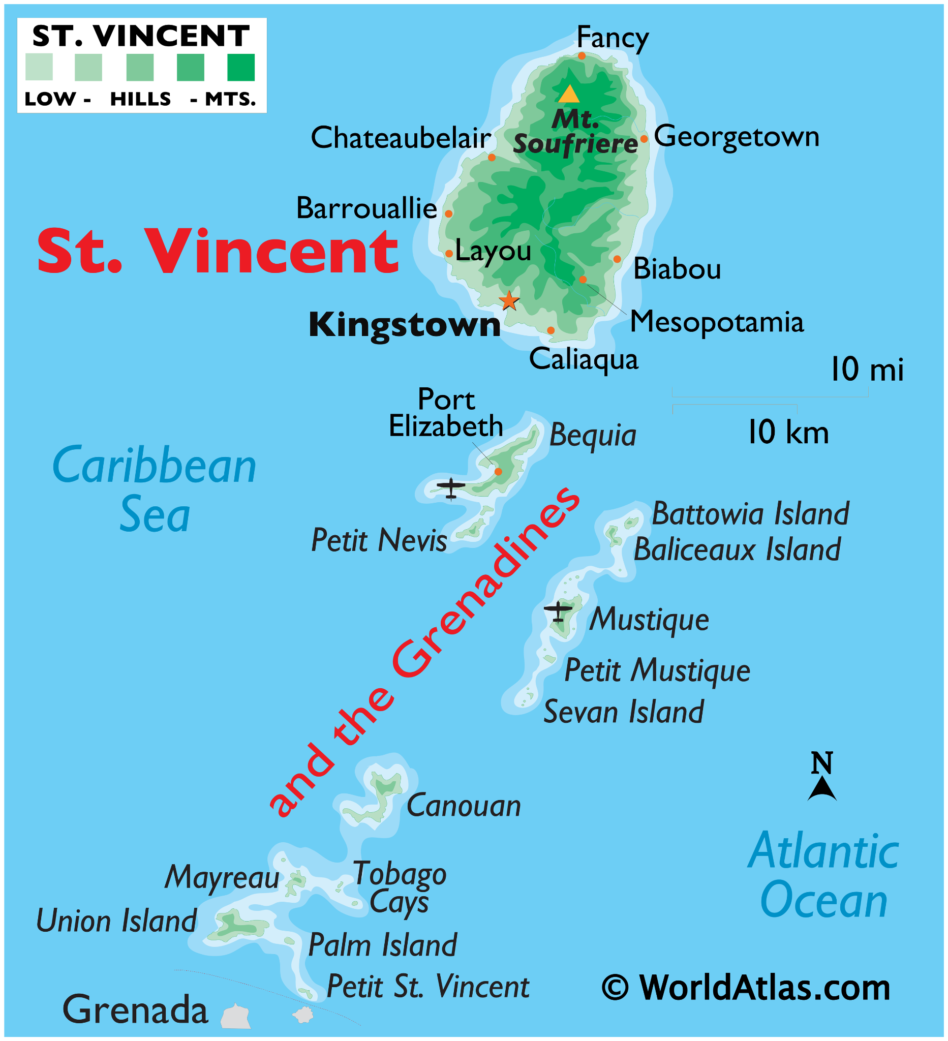
Saint Vincent and the Grenadines (SVG) is located in the Caribbean
The main Island is Saint Vincent
The other Islands are the Grenadines
There are 32 Islands and Cays

Slide 6
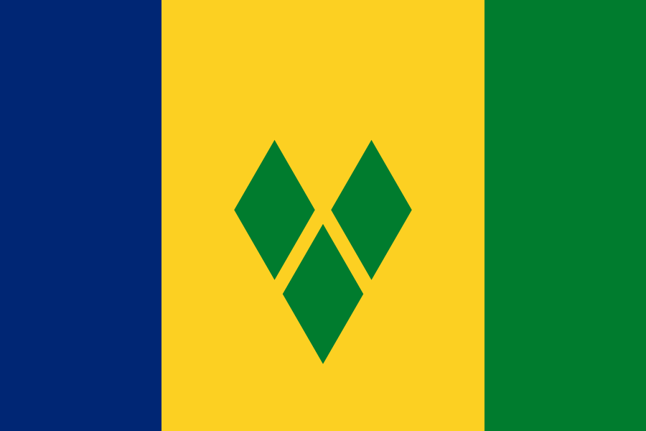
Became an Independent Nation
Before
1979
October 27th
1979
Ruled by the United Kingdom
(Great Britain)
Our Country’s flag

Slide 7
https://youtu.be/oanmq4fcVyM?si=VNGEN6b-Jryr6YC7
https://youtu.be/zjO901WjLJs

Slide 8
Understanding Dialects and Slangs
Dialect
A type of the language that is spoken in a specific part of the country or by a specific group of people. It is more like a local language.
Slang
A type of language that has words and phrases that are viewed as very informal. It is more like an informal language.

Slide 9
Dialects and Slangs in SVG
St.Vincent and the Grenadines speaks both English and Creole.
In creole words are spelt and pronounced differently.
Creole is also called dialect or some other caribbean countries may say broken english

Slide 10
English | SVG Creole
Umbrella | Parasol
Slippers | Gunslingers or draggas
Dish washing liquid | Squeezy
Home | Yard
It is there | It dey dey
Can you come here | Come yah
Come here quickly | Look sharp or make haste
Have a seat | Siddung
That girl is beautiful | She set good or good gyel

Slide 11
English | SVG Creole
I am very tired | Me tired bad bad
A bad boy | Bad john
To take up your belongings | Tek up yo kunhuments
Someone is annoying or harassing you | Yo real bodderation
Troublesome person | Operacious

Slide 12
DEMONSTRATION

Slide 13
QUESTIONS AND ANSWERS

Slide 14
THANK YOU FOR LISTENING
謝謝 :)

