Slide 1
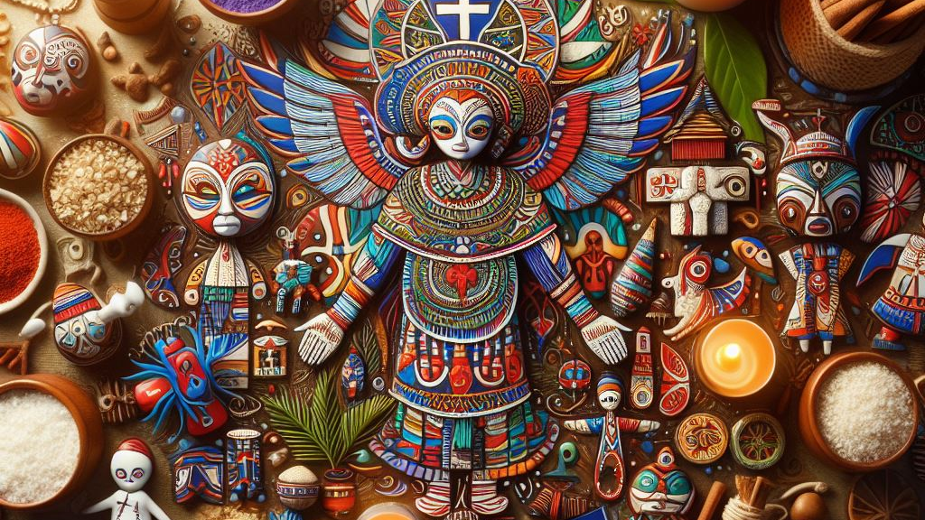
Cultural Taboos in Haiti
Understanding a Vibrant Island Culture
By Emmanuel (貝司)

Slide 2
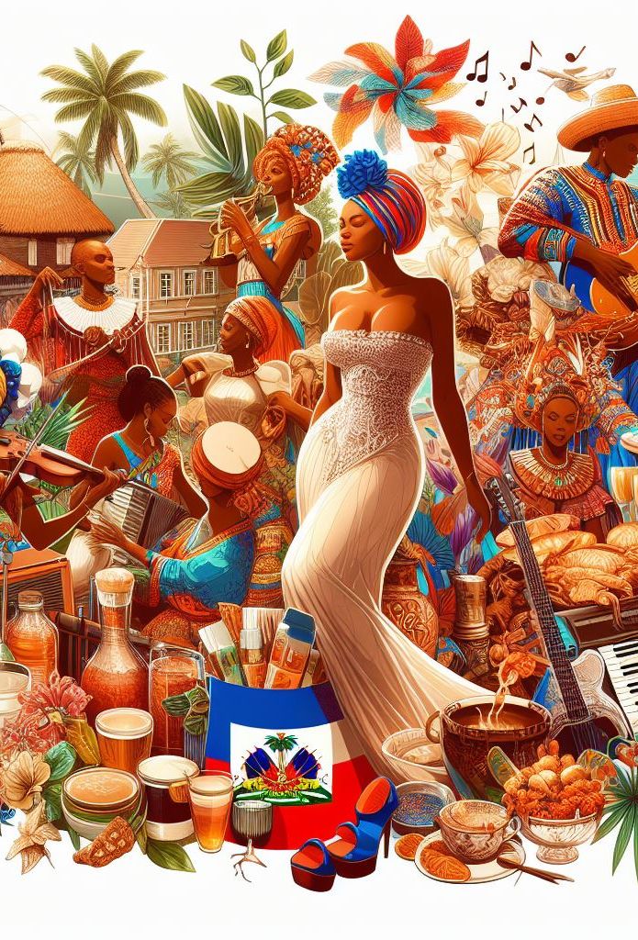
An Overview of Haitian History & Culture
Located on the island of Hispaniola next to the Dominican Republic
First independent nation in Latin America (1804 after slave rebellion)
A unique mix of West African, French, Spanish, and Taino influences
Vodou blends West African spirituality and Catholic rituals
Beautiful artwork in painting, sequin banners, woodcarvings
Spicy cuisine features staples like griot (fried pork), diri djon djon (mushroom rice)

Slide 3
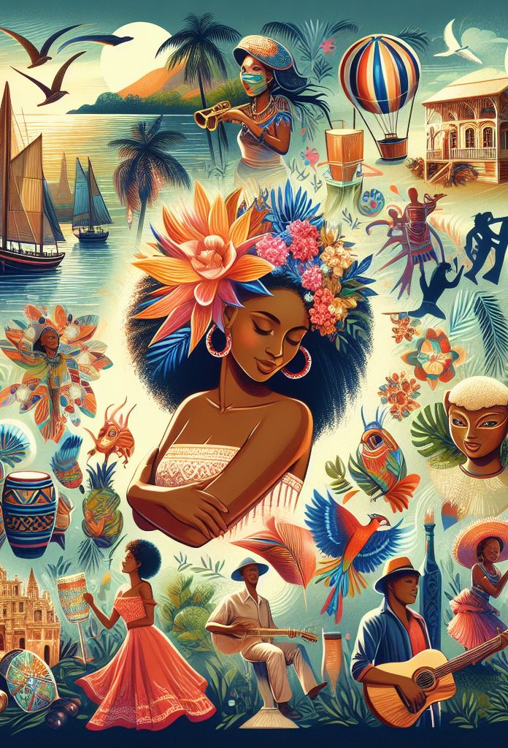
Defining Cultural Taboos
Behaviors considered unacceptable or offensive in a society
Relate to dress, body language, conversation topics and more
Rooted in spiritual beliefs, etiquette around elders, death rituals
Knowing taboos prevents causing unintentional offense

Slide 4
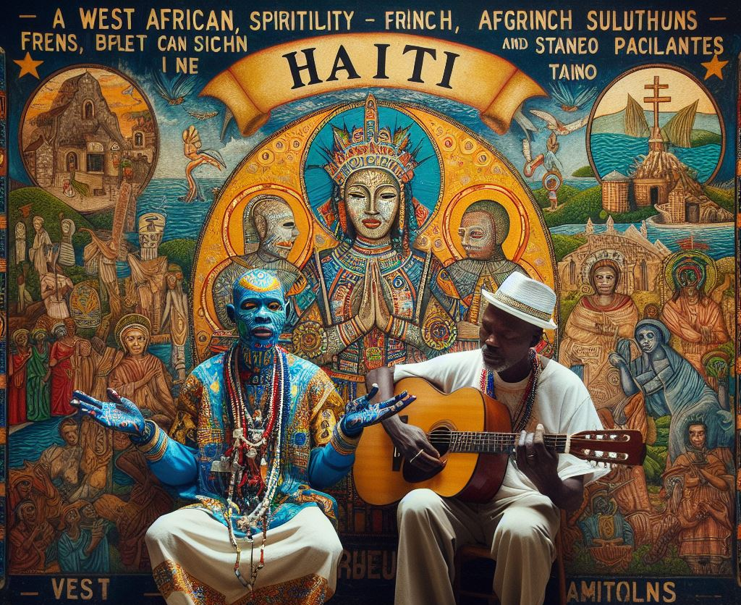
Why Taboos Matter
Shows respect for cultural values, norms, and beliefs
Fosters positive relations when visiting or working in Haiti
Helps avoid souring your experience or damaging ties
Taboo awareness manifests openness and cultural appreciation

Slide 5
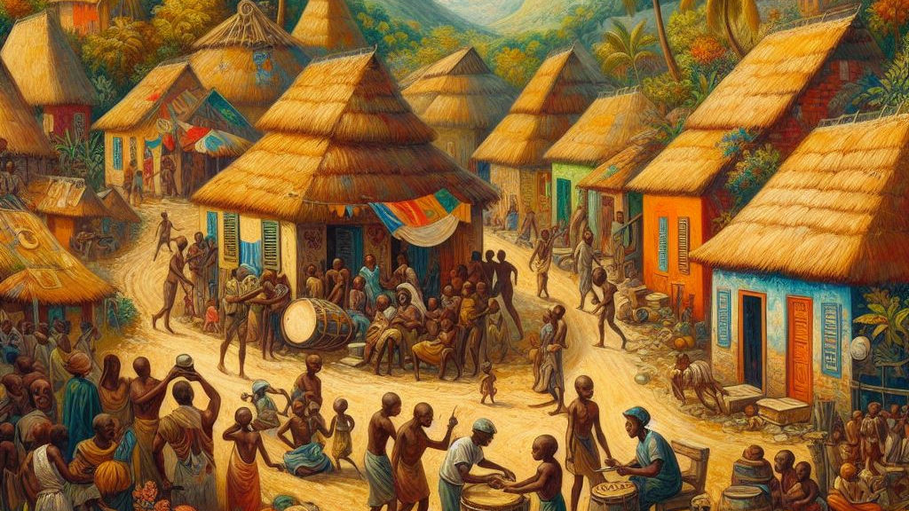
Cultural Taboos in Haiti

Slide 6
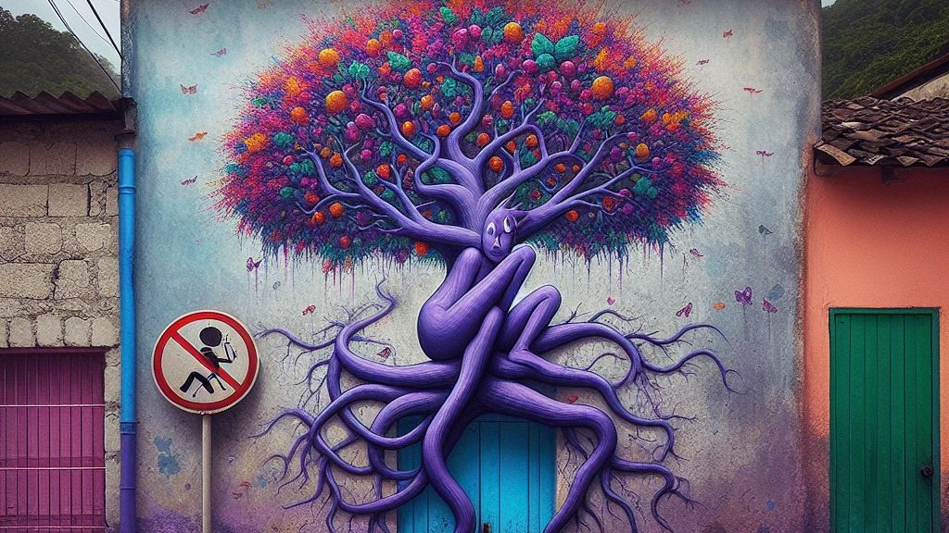
Avoid Color Purple
Associated with grieving rituals & foreboding of death
Never wear purple clothing during celebrations, weddings
Decorating with purple flowers is also unacceptable

Slide 7
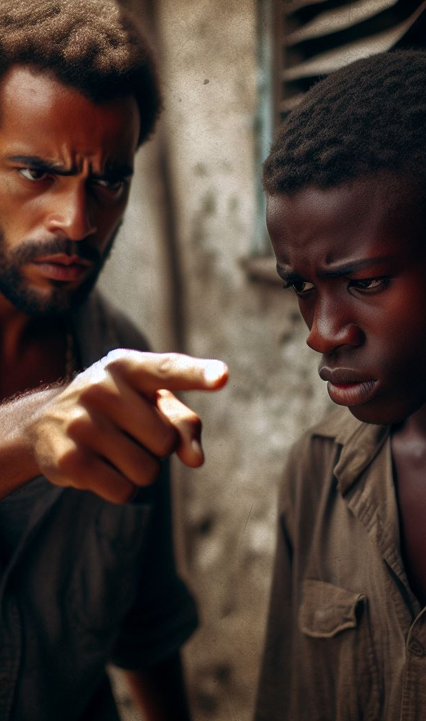
Do Not Point with Fingers
Highly disrespectful and demeaning gesture
Also, very rude to put hands on hips when frustrated

Slide 8
Do Not Whistle at Night
Whistling is thought to attract evil spirits and wicked forces
Avoid whistling near home to not endanger family
Some believe night whistling signals impending death

Slide 9
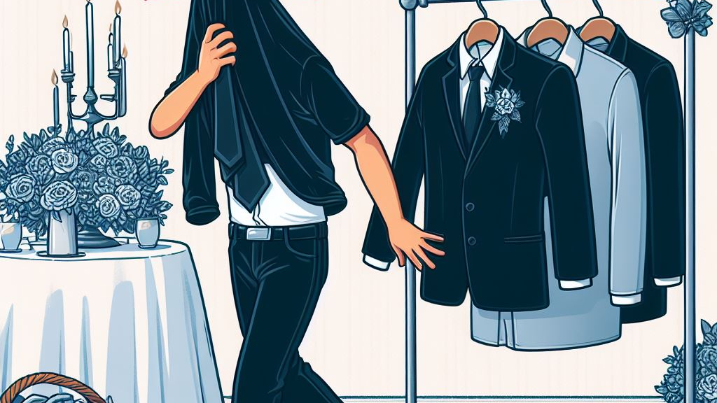
Avoid Wearing Black to Weddings
The color black signifies grief, loss, and death
Inappropriate color when celebrating unions at weddings
Stick to bright, cheerful colors like white, yellow, pink

Slide 10
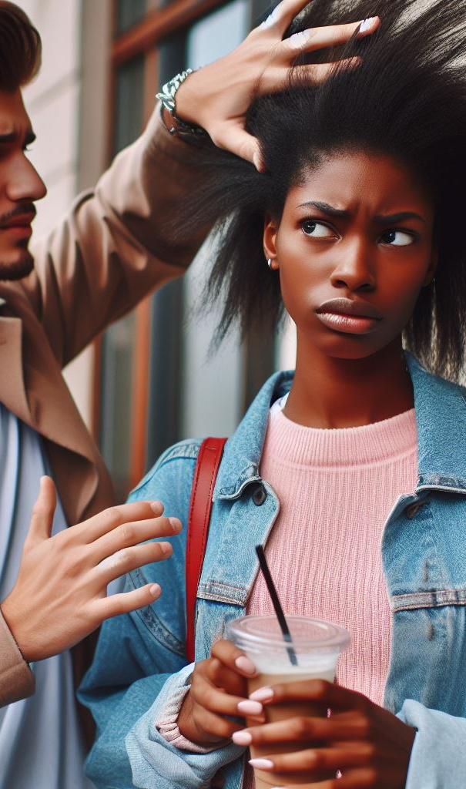
Ask Before Touching Heads
Touching another’s head very offensive
Always ask permission first
Even affectionate touch between couples disrespectful

Slide 11
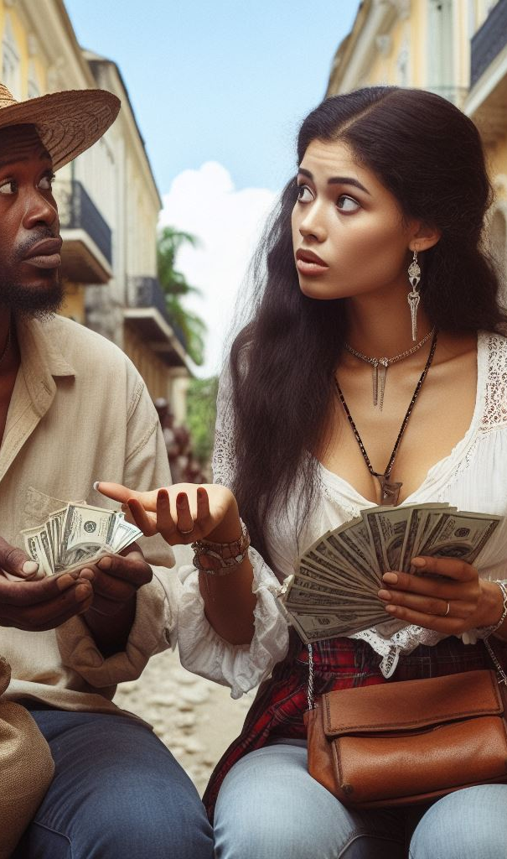
Avoid Discussing Money
Considered a private matter
Don’t ask people about their income or finances
Similarly, don't reveal specifics about your own financial situation

Slide 12
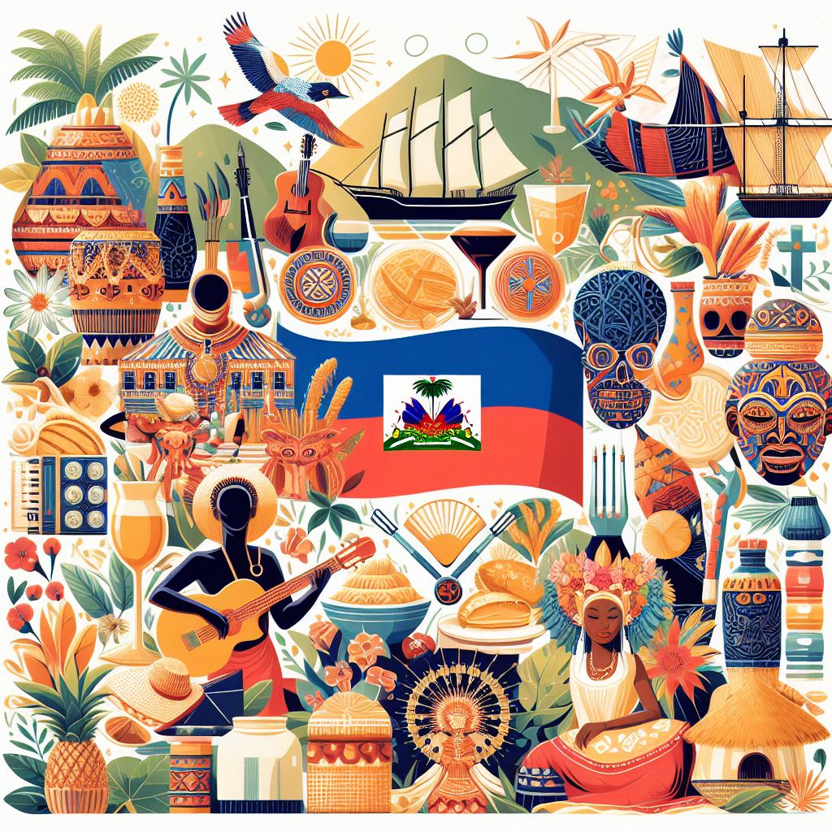
Conclusion
To show respect for Haitian culture, it's important to be aware of their taboos. By learning about the differences in values and avoiding offense, visitors can establish good connections. Familiarity with key taboos helps to facilitate respectful cultural exchange.

Slide 13
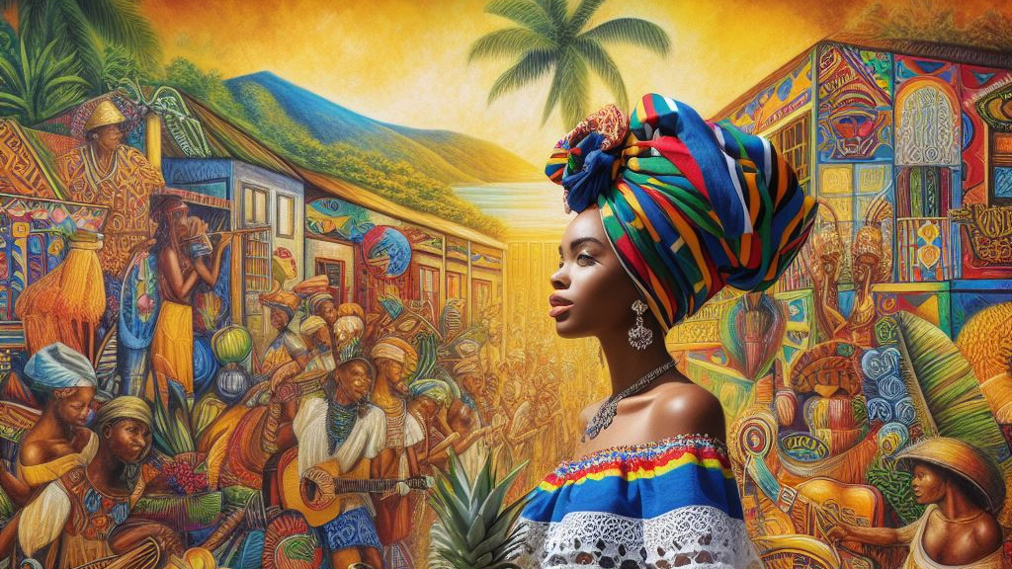
Thank You!

